Slide 1
Evaluation of an experimental herbicide formulation alone, and Caparol in tank mix with Gramoxone 3.0 SL, for weed control and crop safety in cotton using See and Spray Technology
James Holloway
Steven Taylor
2020 Biological Research and Development
Last Updated: OCT-13-2020

Slide 2
Acknowledgements and Test Locations:
Trial | State | Cooperator/ Syngenta Rep | I (IH) / C (CRO) / P (COI) * | Target | Included in Summary/Notes
USSG0H4542020 | TN | James Holloway | C | amaranth, Palmer; barnyardgrass; morningglory, ivyleaf | Y
USSB0H0122020 | MS | Ryan Jackson | I | Prickly sida; Goosegrass | Y
USSB0H2022020 | MS | Ryan Jackson | C | Palmer amaranth; Common barnyard grass; Common purslane | Y
USSE0H4312020 | AR | David Black | P | amaranth, Palmer; barnyardgrass; morningglory, ivyleaf; carpetweed | Y
* Placement C = Contracted Trial I = In-House Trial P = Public Institution Trial

Slide 3
Objectives:
Evaluate experimental formulations of post-emergence herbicides for weed control and crop safety in cotton using See and Spray Technology as compared to the standard application of Induce plus Caparol plus Gramoxone.
Formulations:
1. Does the experimental formulation (treatments 5-8) in combination with adjuvants and drift reducing agents provide control of problem weeds with limited crop response.
2. Does Caparol in tank mixtures with Gramoxone 3.0 SL in combination with drift reducing agents provide control of problem weeds with limited crop response.
Background Information:
See and Spray technology was developed by Blue River Technology. This is a machine based vision system that is installed on a sprayer being pulled by a tractor. The camera/software assesses each plant in the field to determine if it is a weed or a crop. The software then tells the sprayer to direct a spray only on the weed. The value of this technology is that only individual weeds are sprayed and the whole field is not broadcast sprayed, in theory reducing the overall pesticide use. Blue River claims they can target a spray at a weed that is less than one inch from a crop. When using non-selective herbicides such as Gramoxone, it is important the spray targeted at the weed stays on the weed, and not move to the crop. If the sprayer targets a weed less than an inch from a cotton plant, then it is expected that some of the crop will be damaged by drift or bounce.
Syngenta asked the question: Can we develop formulations of Caparol tank mixed with Gramoxone (Caparol for synergistic help in killing weeds) with increased retention that would reduce crop damage in these applications?

Slide 4
Treatment
Trt No. | Trt Name | Product Description | Lot Code | Conc. | Type | Rate | Other Rate | Code | Method | Timing | Placement
1 | A22742 [A] | PROMETRYN (88.8) GA/L |  | 88.8 gA/L | SC | 702 g a/ha | 108 FL OZ/A | A | NONINC | POSPOS | SPOT
1 | GRAMOXONE SL 3.0 | PARAQUAT DICHLORIDE (360) GA/L |  | 360 gA/L | SL | 562 g a/ha | 21.4 FL OZ/A | A | NONINC | POSPOS | SPOT
2 | A22744 [D] | PROMETRYN (44.4) GA/L |  | 44.4 gA/L | SC | 702 g a/ha | 216 FL OZ/A | A | NONINC | POSPOS | SPOT
2 | GRAMOXONE SL 3.0 | PARAQUAT DICHLORIDE (360) GA/L |  | 360 gA/L | SL | 562 g a/ha | 21.4 FL OZ/A | A | NONINC | POSPOS | SPOT
3 | A22744 [E] | PROMETRYN (44.4) GA/L |  | 44.4 gA/L | SC | 702 g a/ha | 216 FL OZ/A | A | NONINC | POSPOS | SPOT
3 | GRAMOXONE SL 3.0 | PARAQUAT DICHLORIDE (360) GA/L |  | 360 gA/L | SL | 562 g a/ha | 21.4 FL OZ/A | A | NONINC | POSPOS | SPOT
4 | A22744 [C] | PROMETRYN (44.4) GA/L |  | 44.4 gA/L | SC | 702 g a/ha | 216 FL OZ/A | A | NONINC | POSPOS | SPOT
4 | GRAMOXONE SL 3.0 | PARAQUAT DICHLORIDE (360) GA/L |  | 360 gA/L | SL | 562 g a/ha | 21.4 FL OZ/A | A | NONINC | POSPOS | SPOT
5 | AMSOL | AMMONIUM SULFATE |  |  | SL | 2.5 % v/v | 2.5 % V/V | B | NONINC | POSPOS | SPOT
5 | EXF16426 [S] | SYN550593 (200) GA/L |  | 200 gA/L | SL | 1000 g a/ha | 68.4 FL OZ/A | B | NONINC | POSPOS | SPOT
6 | AMSOL | AMMONIUM SULFATE |  |  | SL | 2.5 % v/v | 2.5 % V/V | B | NONINC | POSPOS | SPOT
6 | EXF16426 [S] | SYN550593 (200) GA/L |  | 200 gA/L | SL | 1000 g a/ha | 68.4 FL OZ/A | B | NONINC | POSPOS | SPOT
6 | EXF9995 [B] | SLES (200) GA/L |  | 200 gA/L | SL | 1.25 % v/v | 1.25 % V/V | B | NONINC | POSPOS | SPOT
7 | AMSOL | AMMONIUM SULFATE |  |  | SL | 2.5 % v/v | 2.5 % V/V | B | NONINC | POSPOS | SPOT
7 | EXF16426 [S] | SYN550593 (200) GA/L |  | 200 gA/L | SL | 1000 g a/ha | 68.4 FL OZ/A | B | NONINC | POSPOS | SPOT
7 | EXF9995 [B] | SLES (200) GA/L |  | 200 gA/L | SL | 1.25 % v/v | 1.25 % V/V | B | NONINC | POSPOS | SPOT
7 | ONTARGET | AG16098 |  |  | SL | 0.5 % v/v | 0.5 % V/V | B | NONINC | POSPOS | SPOT
8 | AMSOL | AMMONIUM SULFATE |  |  | SL | 2.5 % v/v | 2.5 % V/V | B | NONINC | POSPOS | SPOT
8 | EXF16426 [S] | SYN550593 (200) GA/L |  | 200 gA/L | SL | 1000 g a/ha | 68.4 FL OZ/A | B | NONINC | POSPOS | SPOT
8 | EXF9995 [B] | SLES (200) GA/L |  | 200 gA/L | SL | 1.25 % v/v | 1.25 % V/V | B | NONINC | POSPOS | SPOT
8 | INTERLOCK | PROPRIETARY BLEND |  |  | L | 0.1 % v/v | 0.1 % V/V | B | NONINC | POSPOS | SPOT

Slide 5
Treatments
Caparol Premixes
1. A22742 (A) Caparol + Induce
2. A22744 (D) Caparol + Induce + Ontarget
3. A22744 (E) Caparol + Induce + Interlock
4. A22744 (C) Caparol + Induce + Surfynol 440
All treatments were tank mixed with AMSOL at 2.5% and Gramoxone 3.0
CIPHER
5. EXF16426 (S) = SYN550593
6. EXF16426 (S) = SYN550593 + SLES
7. EXF16426 (S) = SYN550593 + SLES + Ontarget
8 EXF16426 (S) = SYN550593 + SLES + Interlock
All treatments were tank mixed with AMSOL at 2.5%

Slide 6
Number of emerged cotton plants at application / 60 row feet

Slide 7
Number of targeted cotton plants following application / 60 row feet

Slide 8
Number of damaged cotton plants 3 days after application / 60 row feet - Objective

Slide 9
% Damaged cotton plants 4-5 days after application - Subjective

Slide 10
% damaged plants compared to total stand – 3-4 DAA

Slide 11
MS Location
All plants showed symptomology. I saw the same thing last year in my IH trial.
Targeted plants rated immediately after application were low last year, but it appeared that drift affected all plants, particularly the lower leaves. Seems like there were more targeted plants this year than last. Drift symptomology was higher up the plant this year compared with last year.
Beds were higher this year compared with last. I would guess 6” in height from bottom of row middle to top of bed. Last year could have been half that.
I was not there on the day of application due to potential COVID exposure, so I can’t comment on whether the machine rode higher than expected.
Hope this helps.
Ryan Jackson

Slide 12
AR Location
The beds in my COI’s trial were not real deep, but I wouldn’t say real shallow either. Maybe 3 – 4”. I would say “No”, the machine did not have to run higher than normal for a commercial field. There are nice picture of this on the “G” drive (as requested).
Dave Black

Slide 13
% damaged plants compared to total stand – 3-4 DAA
% damaged plants = # damaged plants 3 DAA / (Total stand count – targeted plants)

Slide 14
% Phyto - cotton plants 3-5 days after application -Subjective

Slide 15
% Broadleaf Weed Control - 3-5 days after application

Slide 16
% Broadleaf Weed Control – 8-9 days after application

Slide 17
% Grass Weed Control – 3-5 days after application

Slide 18
% Grass Weed Control – 8-9 days after application

Slide 19
Results: Cotton Response
Cotton stand was excellent across all 4 trials
A22744D provided the least number of targeted plants within the Caparol premixes was least with the A22744D formulation on average, 6.5%. (N=4)
SYN550593 1000 g + AMS 2.5 % provided the lowest targeted cotton plants within the CIPHER compounds, 6.4%. However, as additional adjuvants or drift adjuvants were added to the tank mix, so did the frequency of targeted cotton plants. (N=4)
Number of damaged cotton plants 3 DAA, A22744E provided the least damage within the Caparol premixes, while SYN550593 1000g + AMS 2.5% provided the least cotton damage within the CIPHER compound premixes. (N=2)
Percent of visual damaged cotton plants was high, >80% with all treatments, (N=2)
Percent PHYTO, was 20% or less with all Caparol premixes with A22744E providing the lease on average. Within the CIPHER premixes, SYN550593 1000 g + AMS 2.5 % provided the lowest phyto, <20% (N+4)

Slide 20
Results: Weed Control
Broadleaf weed control was >90% at 3-5 DAA with all Caparol premixes, this was also true at the 8-9 DAA, however, A22744D did provide the overall highest broadleaf weed control as well as the most consistent.
Broadleaf weed control averaged 87-95% with the CIPHER tank mixes, 3-5 DAA. However, by 8-9 DAA, control was less than 90% with the CIPHER compounds, except for SYN550593 1000g + AMS 2.5% + SLES 1.25% + Ontarget 0.5%.
Grass weed control was >90% at 3-5 DAA with all Caparol premixes, this was also true at the 8-9 DAA, however, A22744D did provide the overall highest grass weed control as well as the most consistent.
Grass weed control averaged 82-95% with the CIPHER tank mixes, 3-5 DAA. However, by 8-9 DAA, control was equal or greater than 90% with all the CIPHER compounds tank mixes, with SYN550593 1000g + AMS 2.5% + SLES 1.25% + Ontarget 0.5% providing the overall highest broadleaf weed control as well as the most consistent.

Slide 21
Summary: Objectives answered & additional conclusions/observations
1. Does the experimental formulation (treatments 5-8) in combination with adjuvants and drift reducing agents provide control of problem weeds with limited crop response.
Broadleaf and grass weed control was the best with SYN550593 1000g + AMS 2.5% + SLES 1.25% + Ontarget 0.5%.
SYN550593 1000 g + AMS 2.5 % provided the lowest crop response in regard to targeted cotton plants, 6.4%. However, as additional adjuvants or drift adjuvants were added to the tank mix, so did the frequency of targeted and damaged cotton plants, resulting in 20% or greater damage.

Slide 22
Summary: Objectives answered & additional conclusions/observations
2. Does Caparol in tank mixtures with Gramoxone 3.0 SL in combination with drift reducing agents provide control of problem weeds with limited crop response.
A22744D formulation provided the highest and most consistent broadleaf and grass weed control.
A22744D provided the least number of targeted plants at application.
However, the least number of damaged plants and % phyto at 3 DAA occurred with A22744E formulation.

Slide 23
Recommendations:
Continue to evaluate A22744D and A22744E for weed control using the Blue River Technology.
CIPHER experimental – continue to look at this chemistry in the Blue River Technology. Consider putting this chemistry into a formulation similar to the Caparol premixes in hopes of lowering crop response and increases weed control.
Consider using OnTarget as the drift agent in the formulations due to the better weed control with both formulations

Slide 24
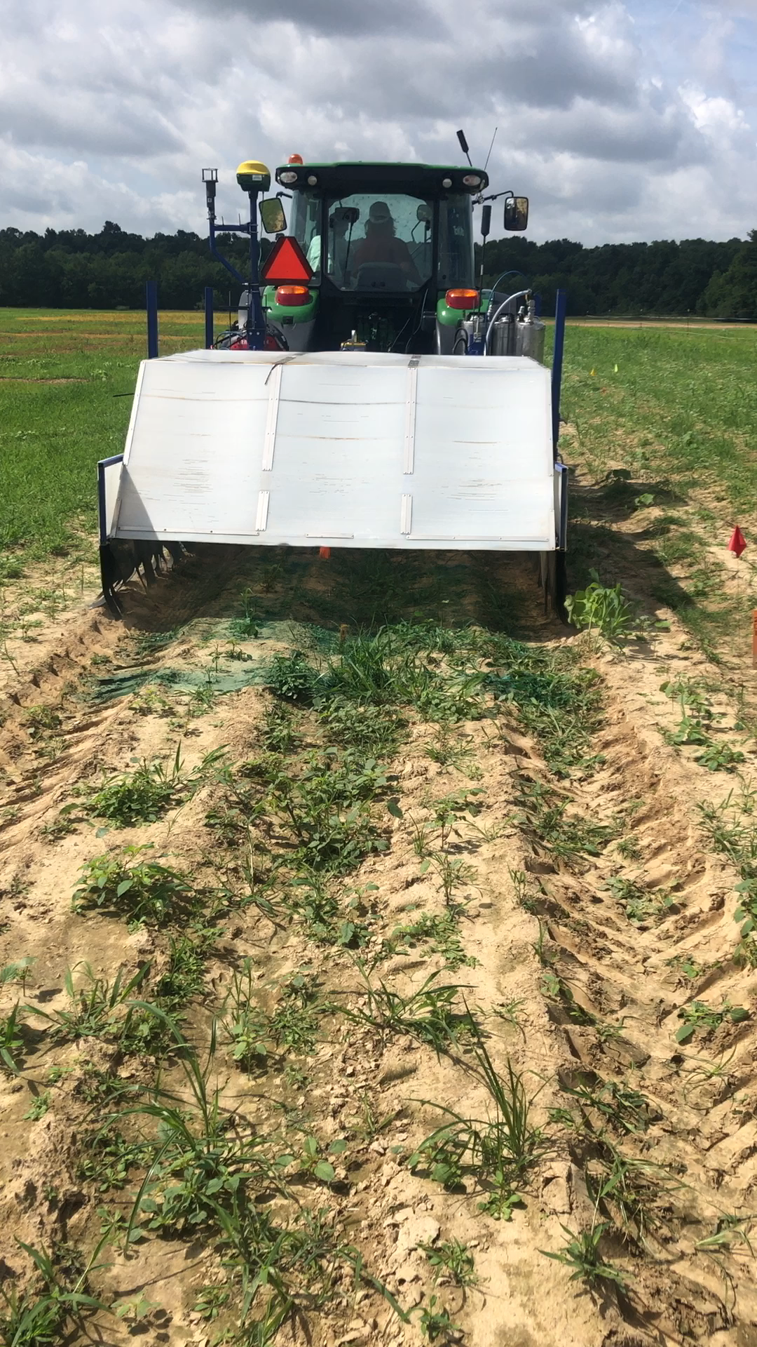
TN Location
Tostitos spraying June 28th, 2020
Spraying was delayed a week due to wet weather and weeds got bigger than wanted
Allot of deer damage at this location

Slide 25
Title: Evaluation of an experimental herbicide formulation alone, and Caparol in tank mix with Gramoxone 3.0 SL, for weed control and crop safety in cotton using See and Spray Technology
Trial: USSG0H4542020
SITE INFORMATION:
Location: Holloway James FS
Address: 7518 Smythe Farm Rd Memphis, TN
Soil Texture: Tillage Type: conventional-till
PLOT WIDTH: 6.333 ft REPS: 3
PLOT LENGTH: 100 ft TREATMENTS: 8
STUDY DESIGN: RACOBL
OVERALL MOISTURE CONDITION:
APPL Date Soil Temperature Moisture:
A Jun-28-2020 81 f GOOD
B Jun-28-2020 81 f GOOD
CROP INFORMATION:
CROP: GOSSS Variety: DP1646B2XF
PLANTING DATE: May-26-2020 PLANTING_METHOD: direct drilled
PLANTING RATE: 4 Depth: 1 in

Slide 26
Pest at Application
Pest Stage At APPLICATION:
A Jun-28-2020
Pest: AMAPA Amaranthus palmeri amaranth, Palmer
Pest Height: 2 in 7
Stage: 14 15
Density: 2 pla/m2
Pest: ECHCG Echinochloa crus-galli barnyardgrass
Pest Height: 8 in 12
Stage: 12 17
Density: 7 pla/m2
Pest: IPOHE Ipomoea hederacea morningglory, ivyleaf
Pest Height: 1 in 2
Stage: 11 12
Density: 2 pla/m2
B Jun-28-2020
Pest: AMAPA Amaranthus palmeri amaranth, Palmer
Pest Height: 2 in 7
Stage: 14 15
Density: 2 pla/m2

Slide 27
Pest at Application
B Jun-28-2020
Pest: ECHCG Echinochloa crus-galli barnyardgrass
Pest Height: 1 in 5
Stage: 12 17
Density: 7 pla/m2
Pest: IPOHE Ipomoea hederacea morningglory, ivyleaf
Pest Height: 1 in 2
Stage: 11 12
Density: 2 pla/m2

Slide 28
Application Code: A
Date Time: Jun-28-2020:10:45
EQUIPMENT: Tostitos
NOZZLE TYPE: FLAEVE
SPACING: 4 in
BOOM LENGTH:
BAND WIDTH:
GROUND SPEED: 4 mph
PRESSURE: 28 psi
SPRAY VOLUME: 55 gal/ac
SPRAY Ph:
WEATHER AT APPLICATION:
Timing: POSPOS
AIR TEMP: 88 f

Slide 29
Application Code: B
Date Time: Jun-28-2020:11:20
EQUIPMENT: Tostitos
NOZZLE TYPE: FLAEVE
SPACING: 4 in
BOOM LENGTH:
BAND WIDTH:
GROUND SPEED: 4 mph
PRESSURE: 28 psi
SPRAY VOLUME: 55 gal/ac
SPRAY Ph:
WEATHER AT APPLICATION:
Timing: POSPOS
AIR TEMP: 89 f

Slide 30
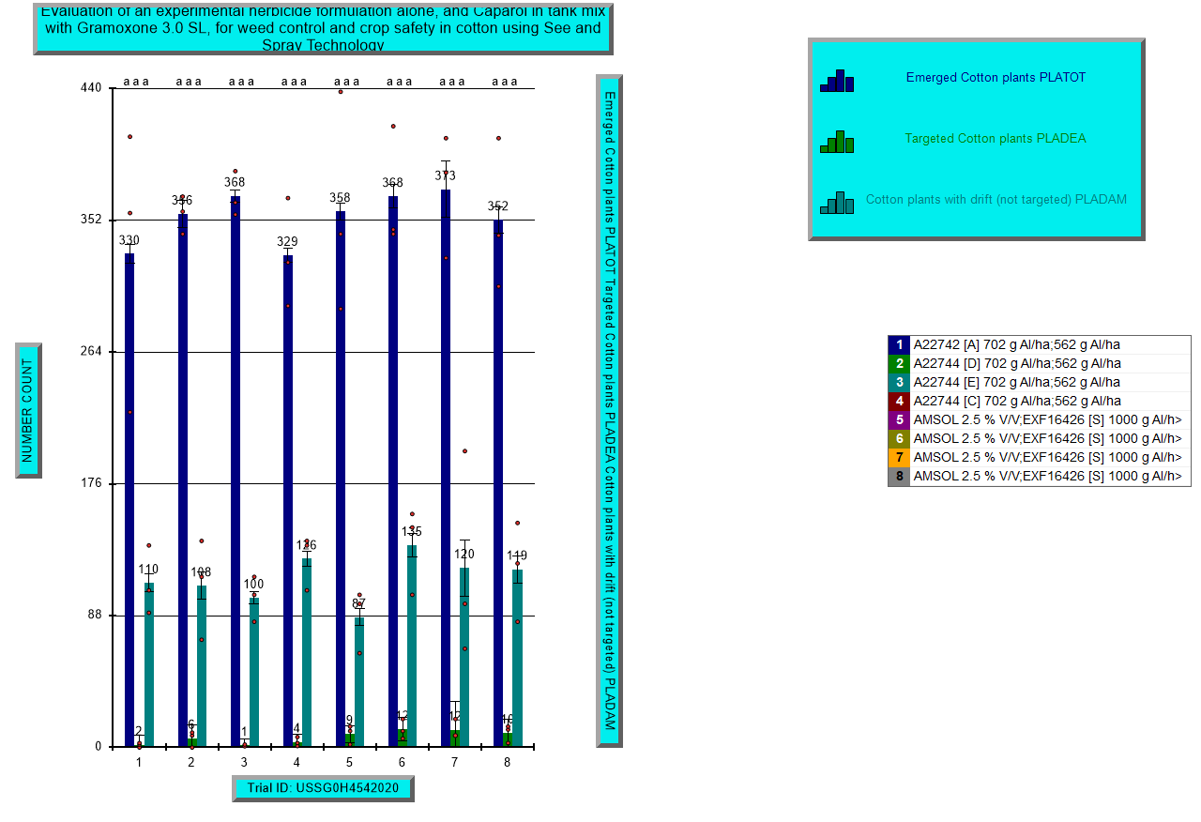
Cotton Plants: Total emerged, targeted at application and damaged 3 days after application – TN

Slide 31
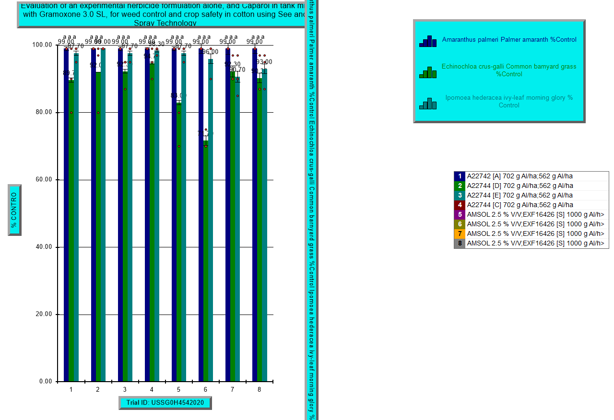
Weed Control – 3 days after application – TN

Slide 32
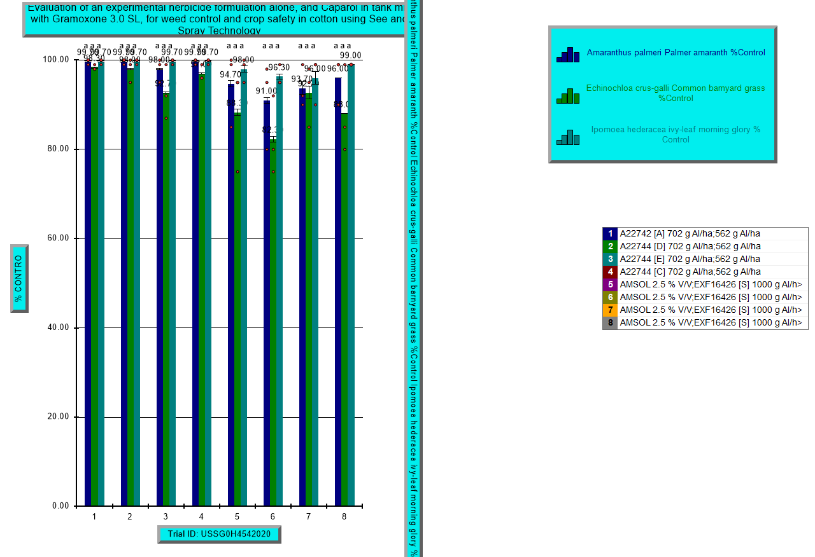
Weed Control – 8 days after application – TN

Slide 33
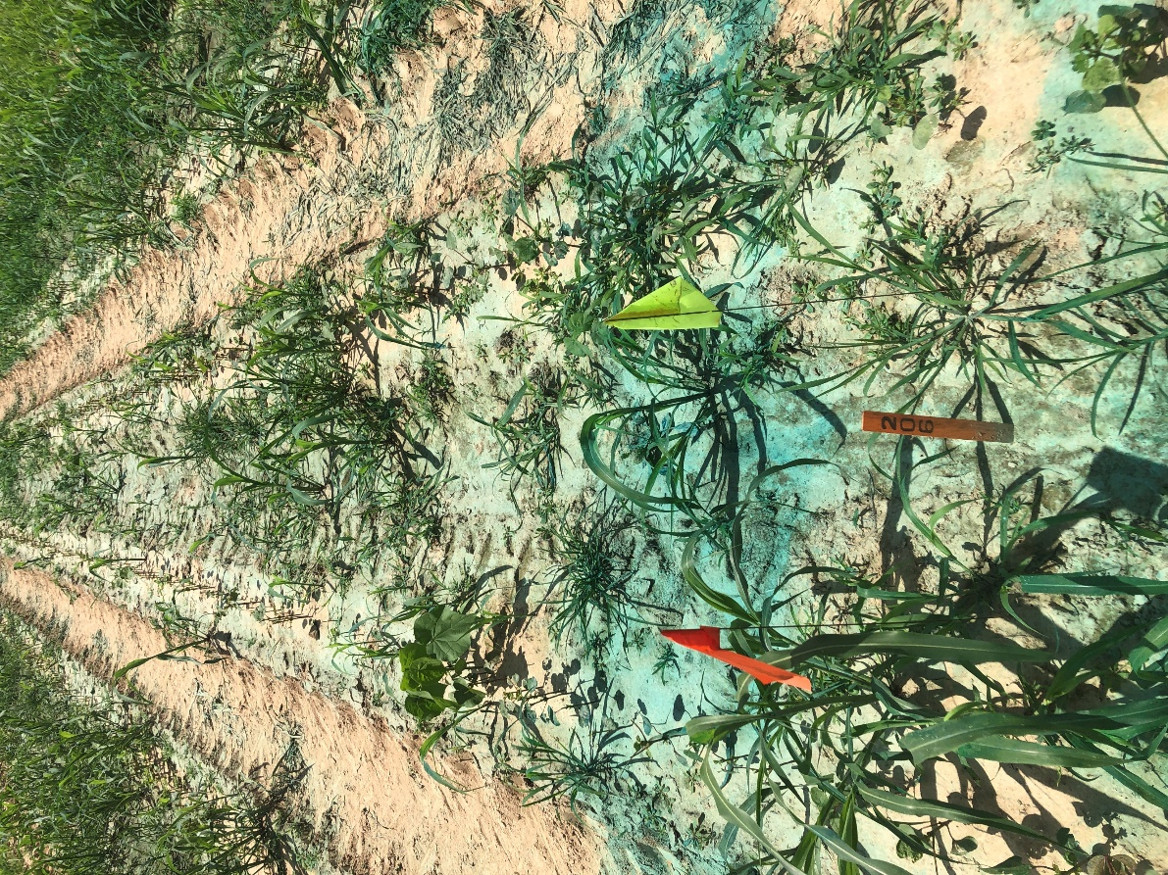
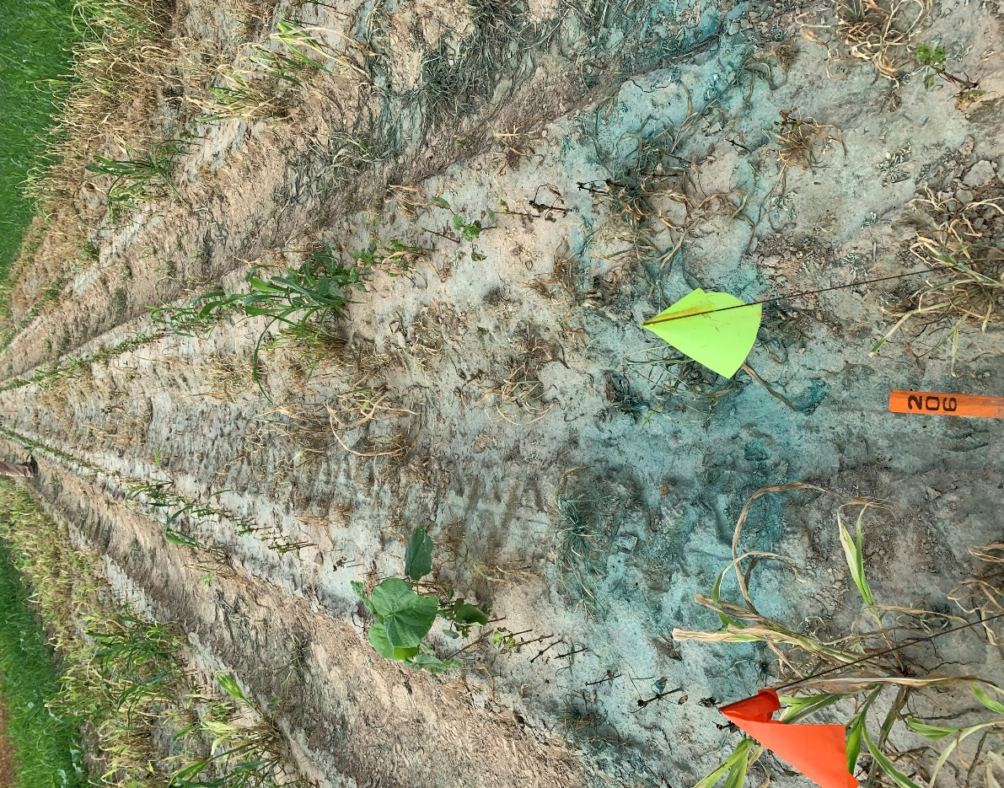
Trt 1: A22742 [A] 702 g a/ha + GRAMOXONE SL 3.0 562 g a/ha
Day of Spray 3 days after spray

Slide 34
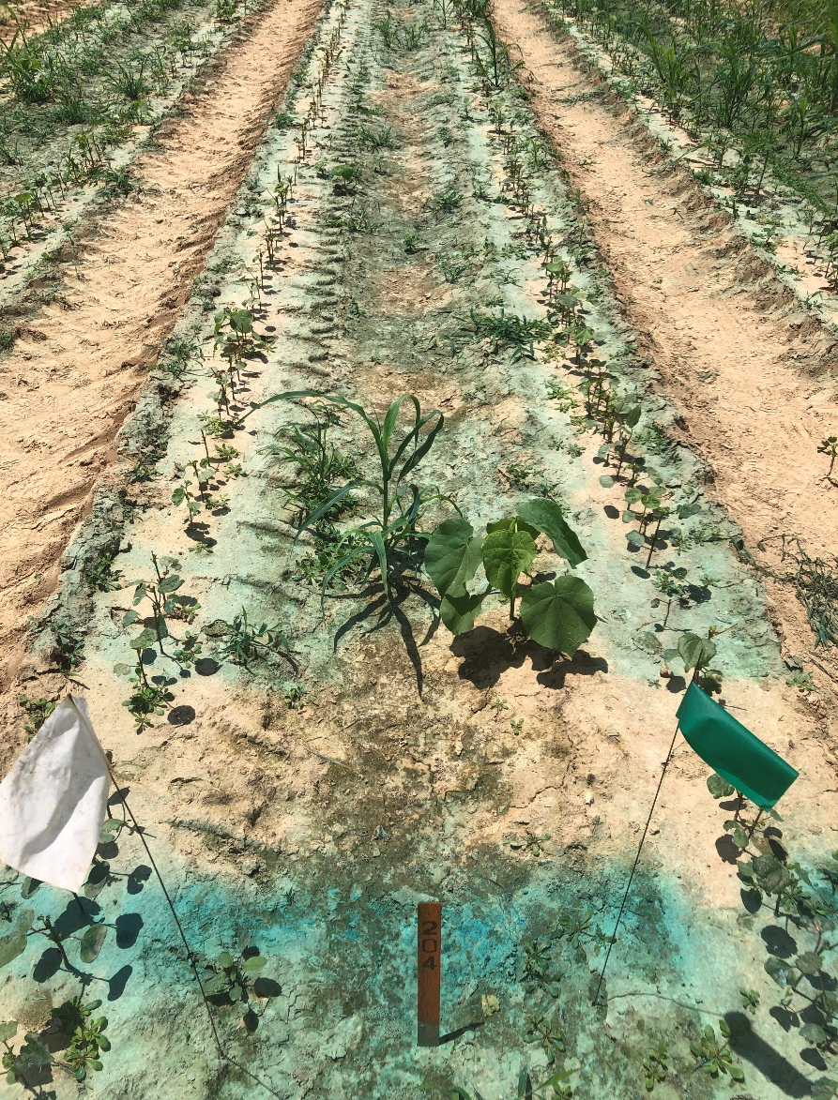
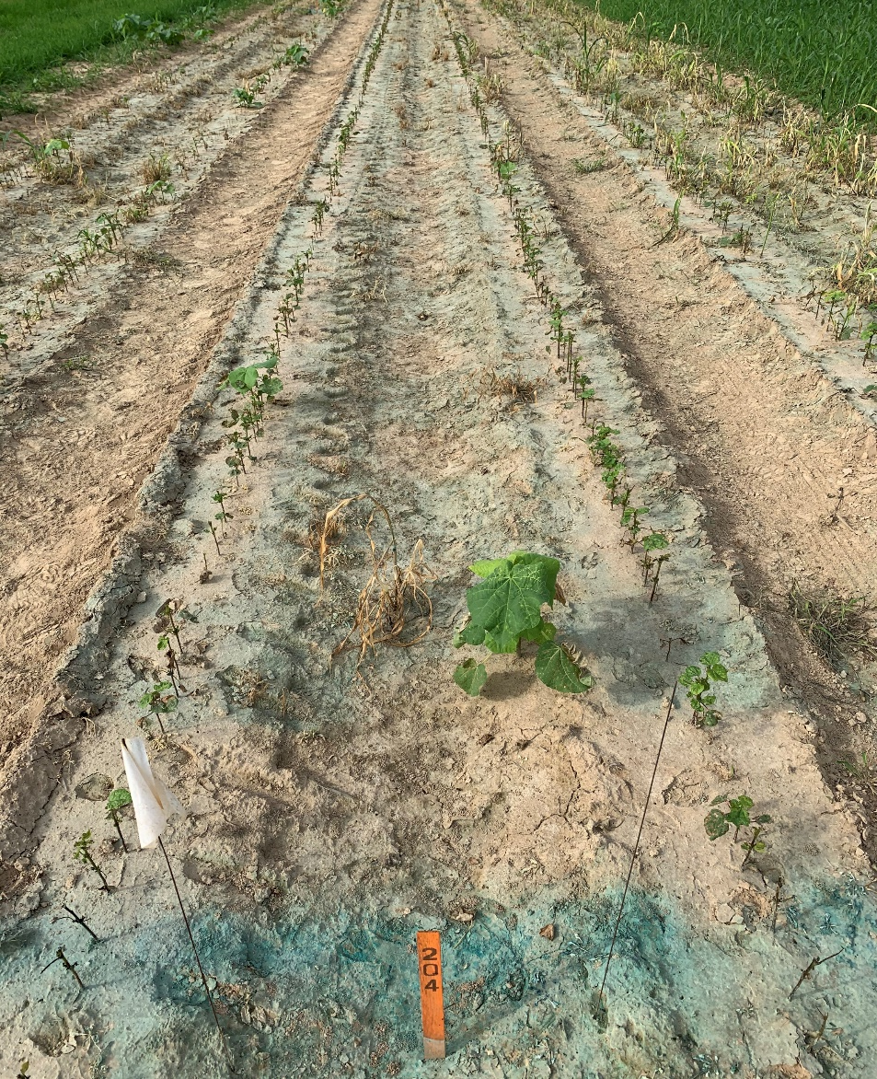
Trt 2: A22744 [D] 702 g a/ha + GRAMOXONE SL 3.0 562 g a/ha
Day of Spray 3 days after spray

Slide 35
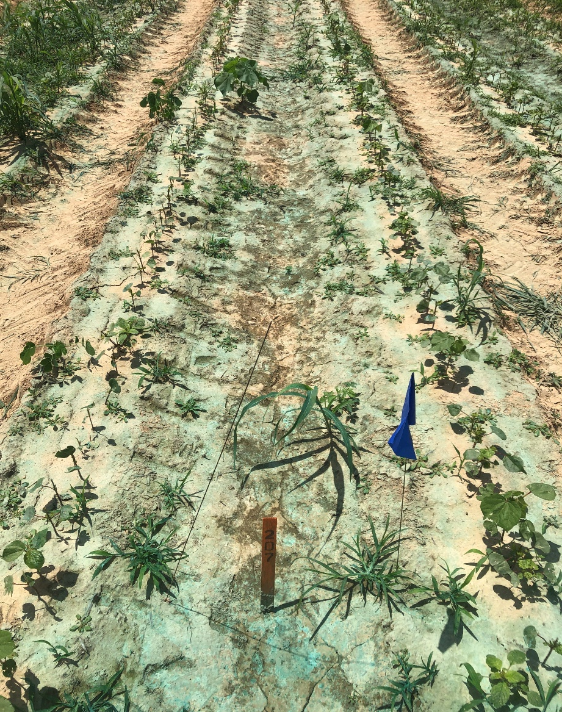
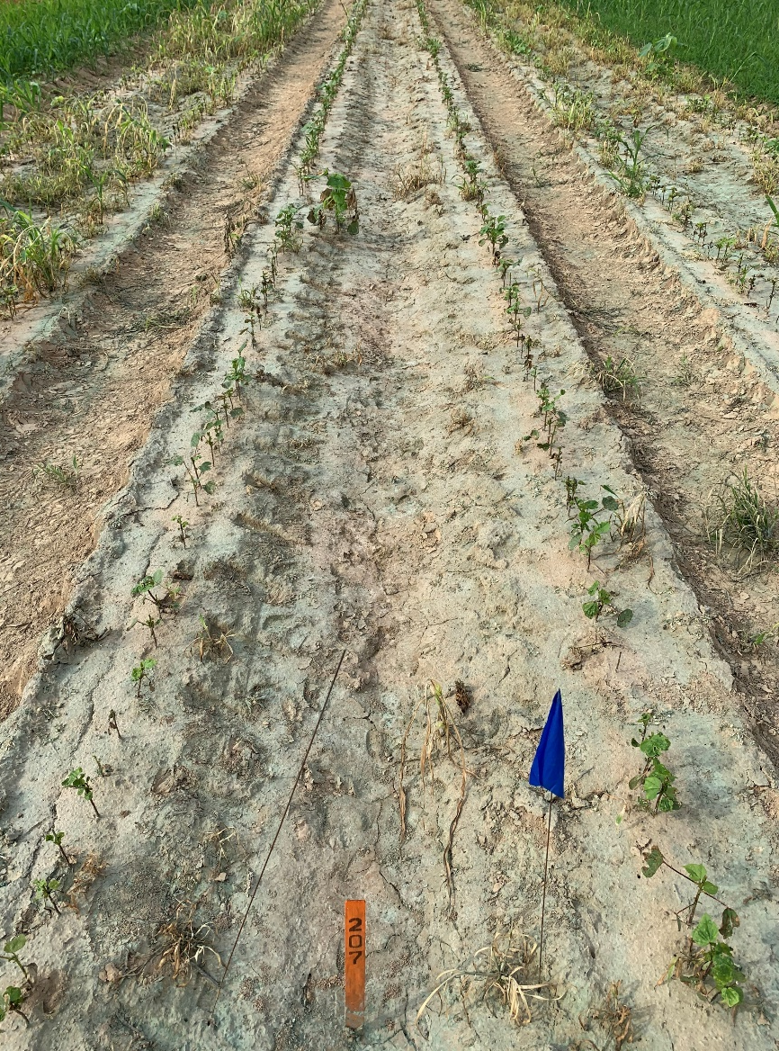
Trt 3: A22744 [E] 702 g a/ha + GRAMOXONE SL 3.0 562 g a/ha
Day of Spray 3 days after spray

Slide 36
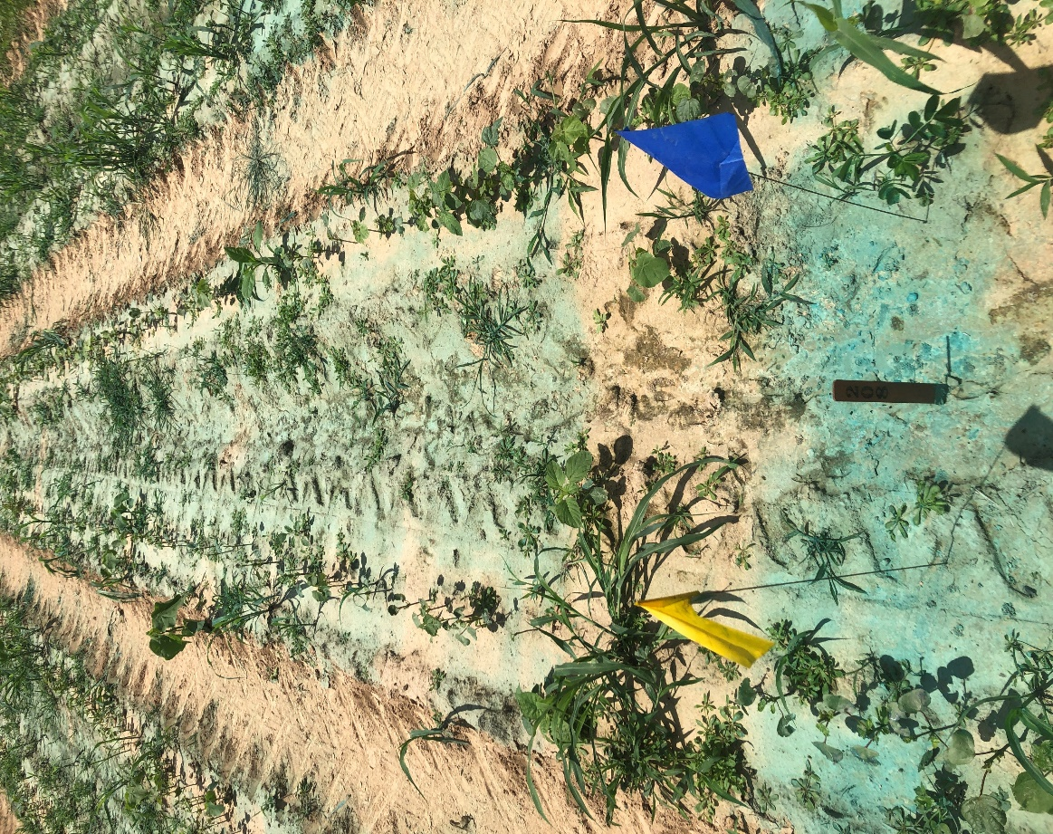
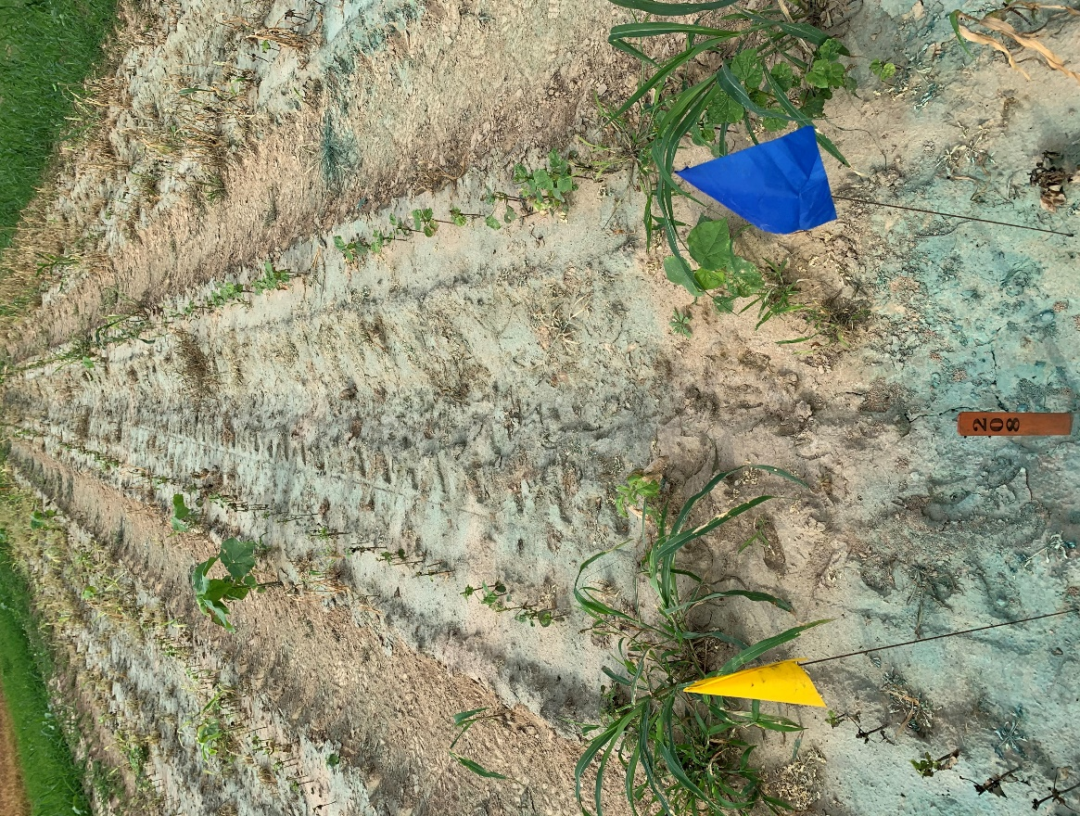
Trt 4: A22744 [C] 702 g a/ha + GRAMOXONE SL 3.0 562 g a/ha
Day of Spray 3 days after spray

Slide 37
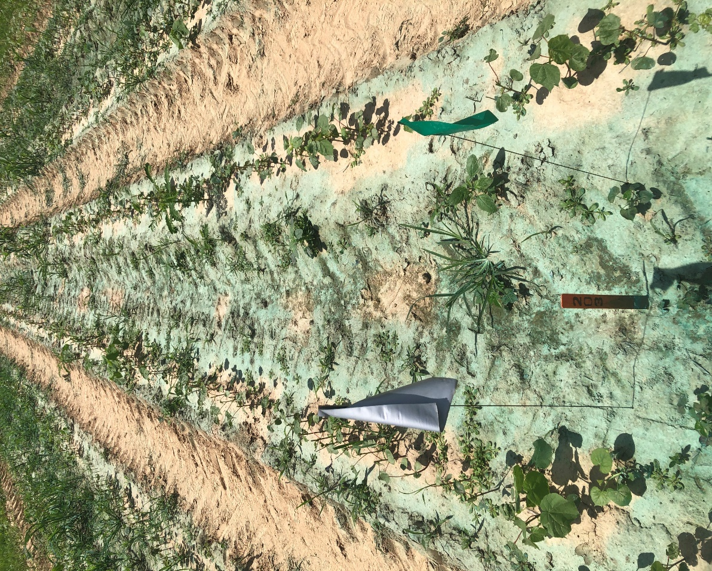
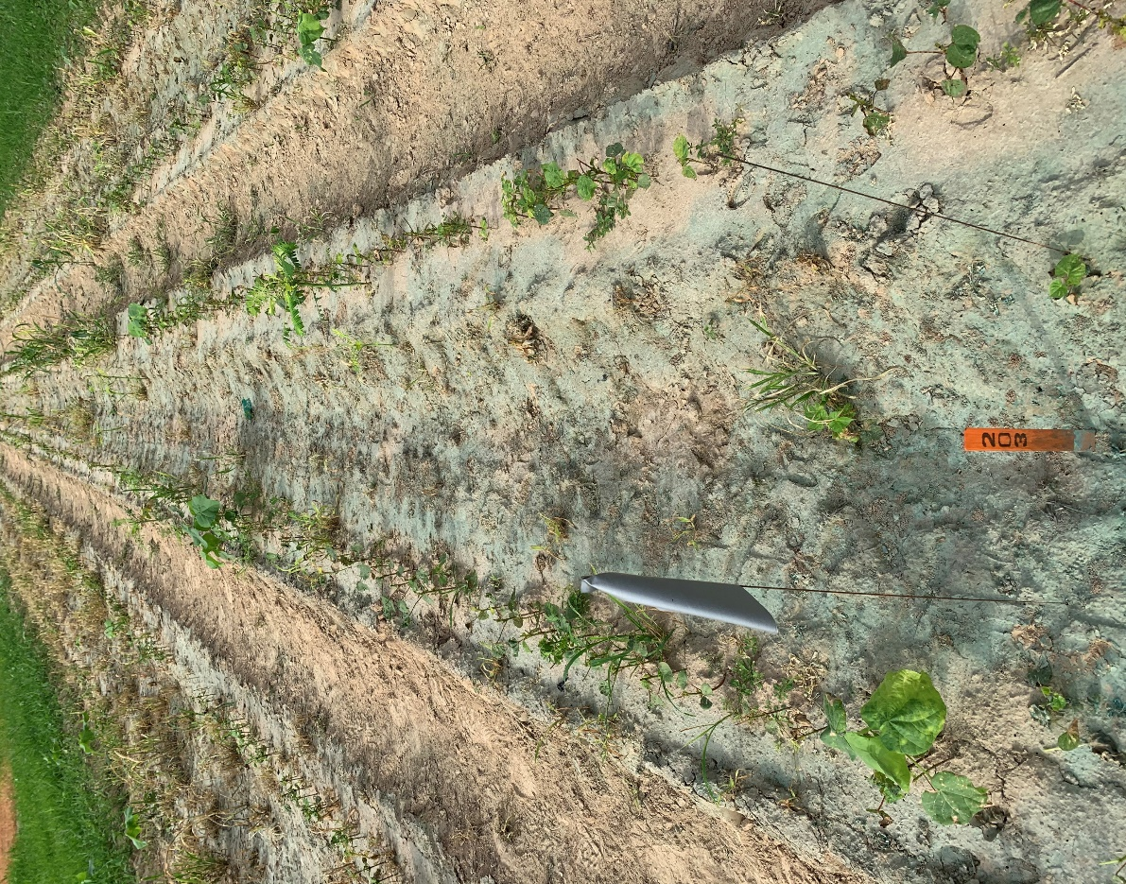
Trt 5: AMSOL 2.5 % v/v + SYN550593 (200) GA/L 1000 g a/ha
Day of Spray 3 days after spray

Slide 38
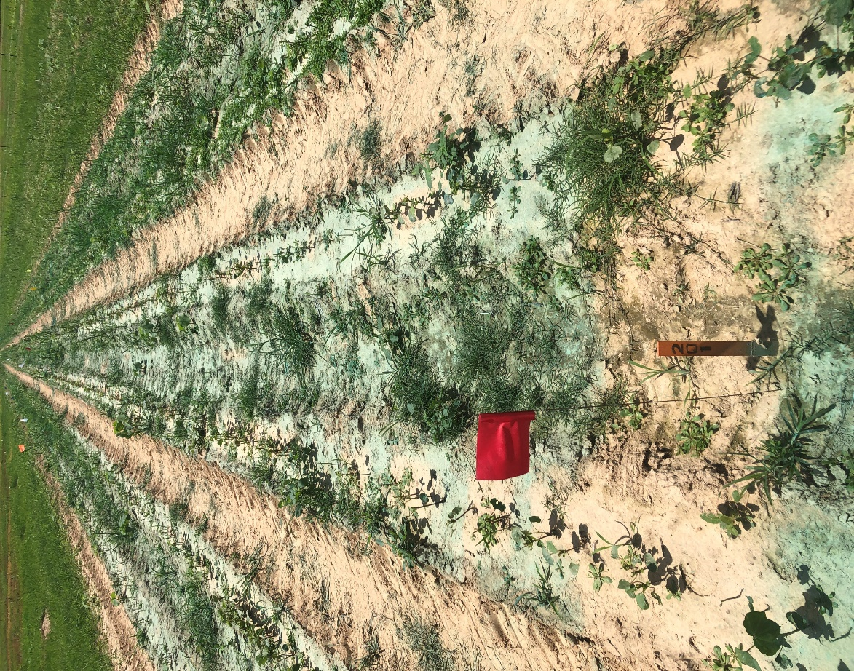
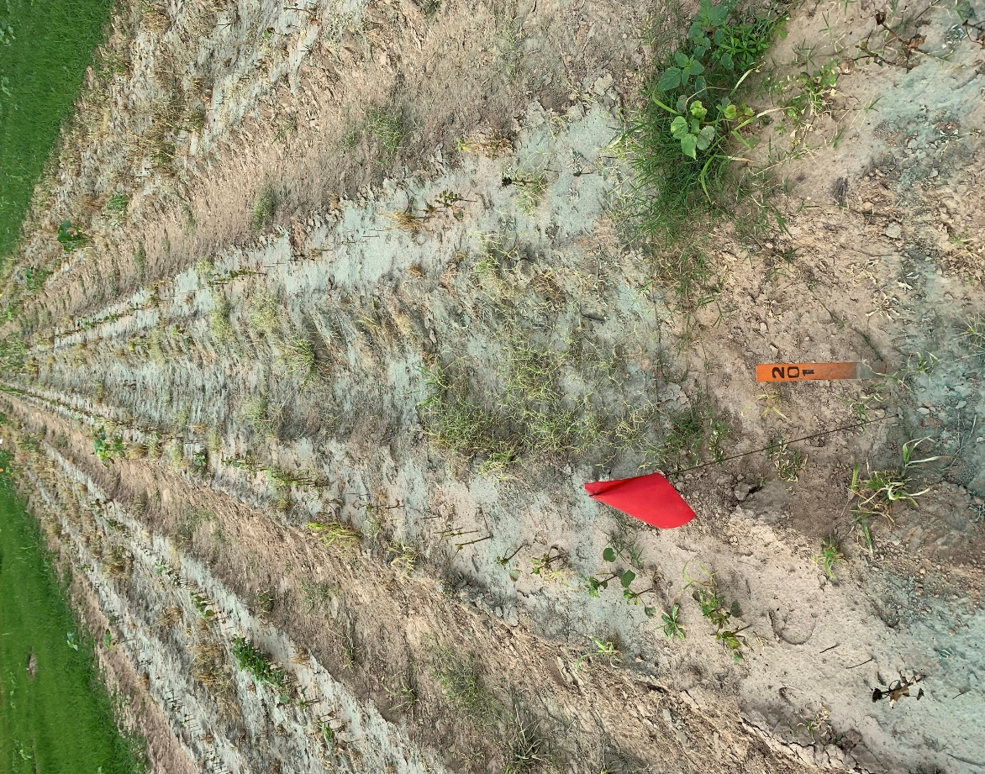
Trt 6: AMSOL 2.5 % v/v + SYN550593 (200) GA/L 1000 g a/ha + SLES (200) GA/L 1.25 % v/v
Day of Spray 3 days after spray

Slide 39
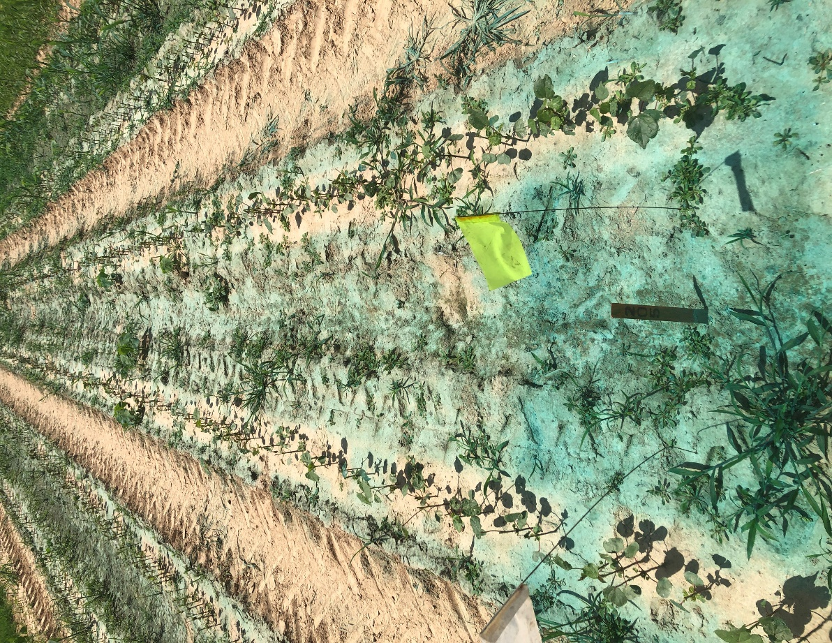
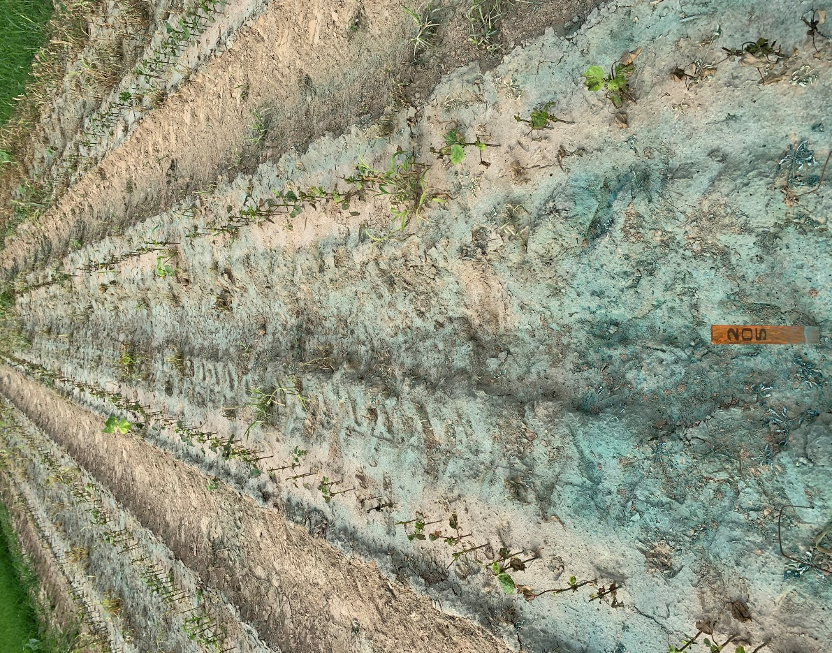
Trt 7: AMSOL 2.5 % v/v + SYN550593 (200) GA/L 1000 g a/ha + SLES (200) GA/L 1.25 % v/v + ONTARGET 0.5 % v/v
Day of Spray 3 days after spray

Slide 40
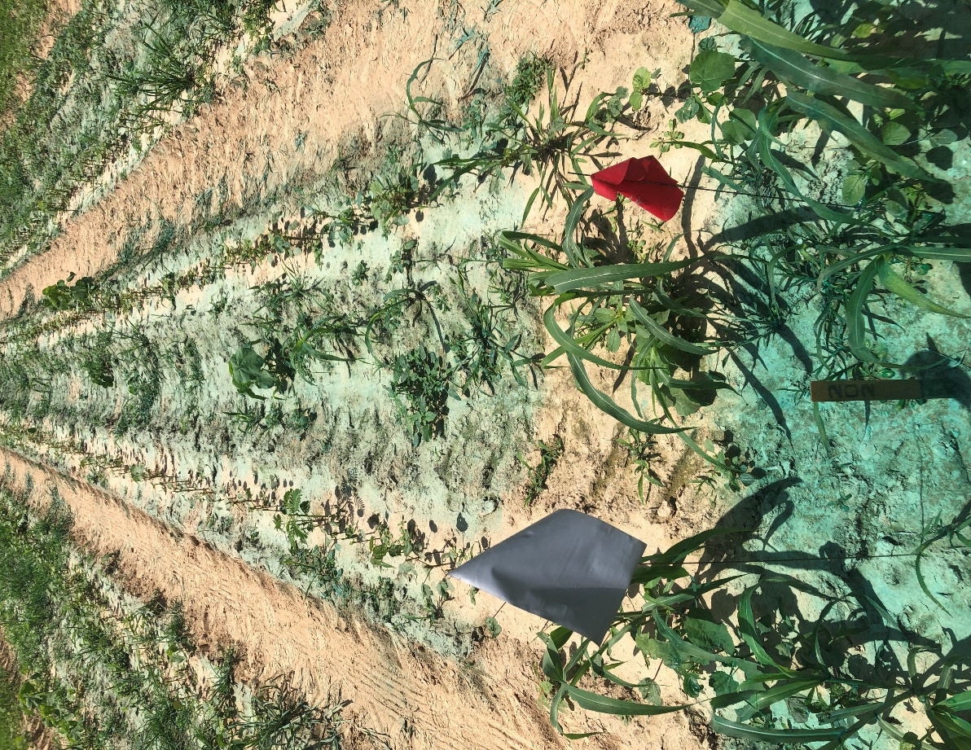
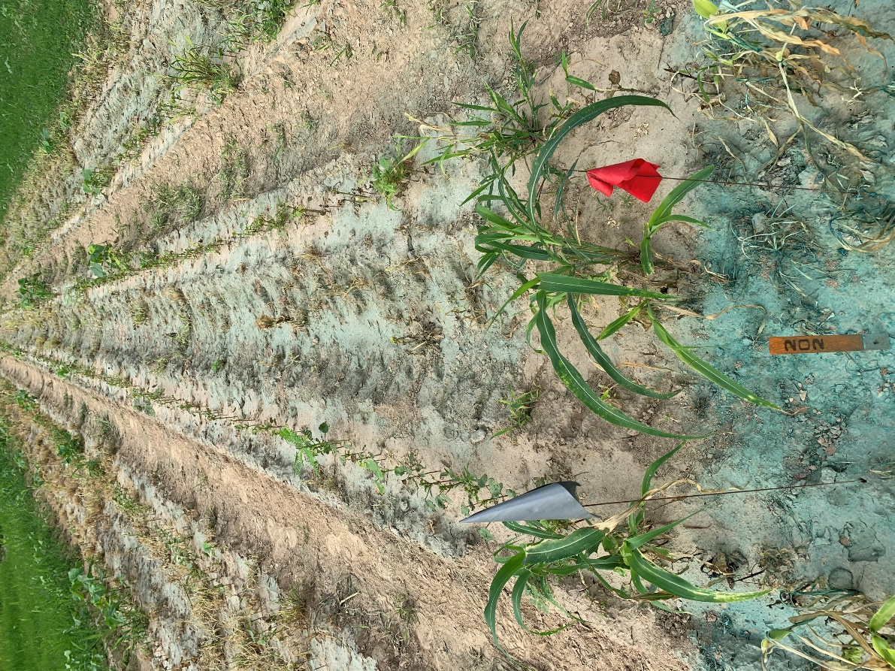
Trt 8: AMSOL 2.5 % v/v + SYN550593 (200) GA/L 1000 g a/ha + SLES (200) GA/L 1.25 % v/v + INTERLOCK 0.1 % v/v
Day of Spray 3 days after spray

Slide 41
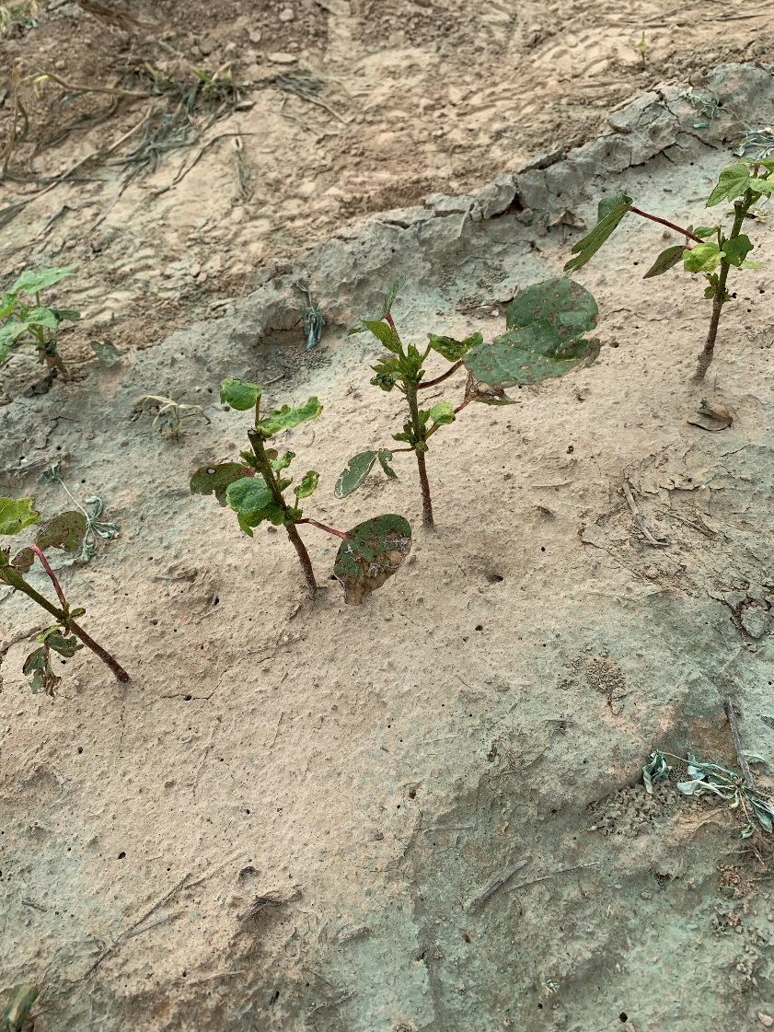
Trt 1: A22742 [A] 702 g a/ha + GRAMOXONE SL 3.0 562 g a/ha – 3 day after spray cotton close up

Slide 42
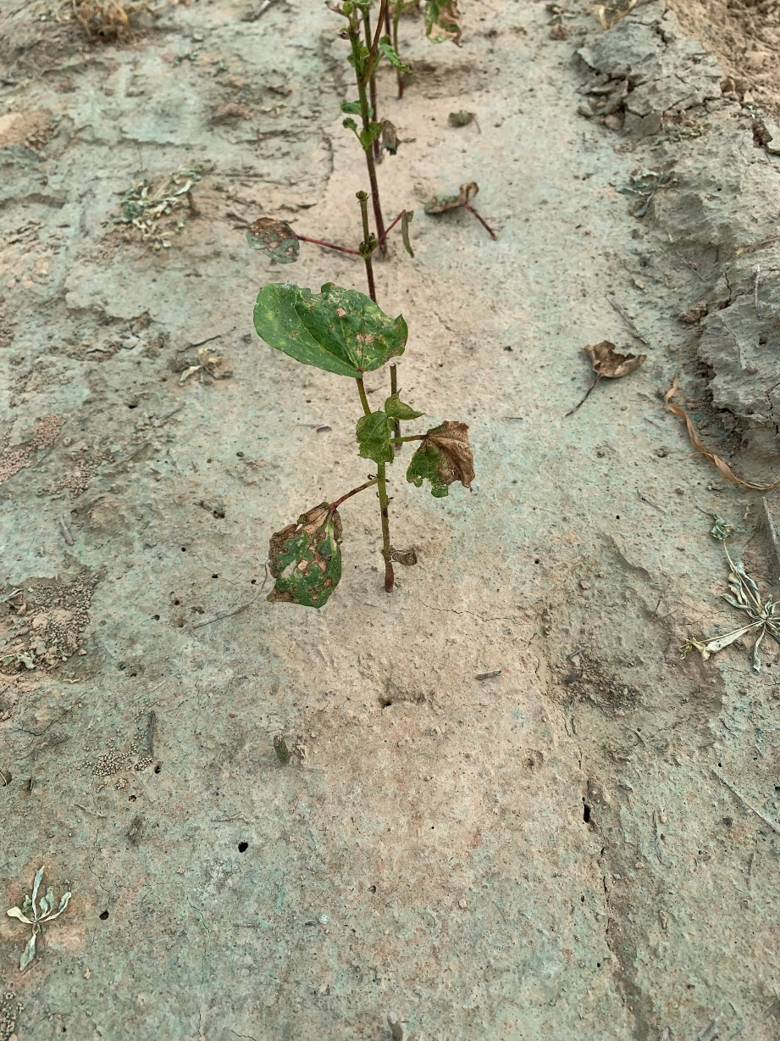
Trt 2: A22744 [D] 702 g a/ha + GRAMOXONE SL 3.0 562 g a/ha – 3 day after spray cotton close up

Slide 43
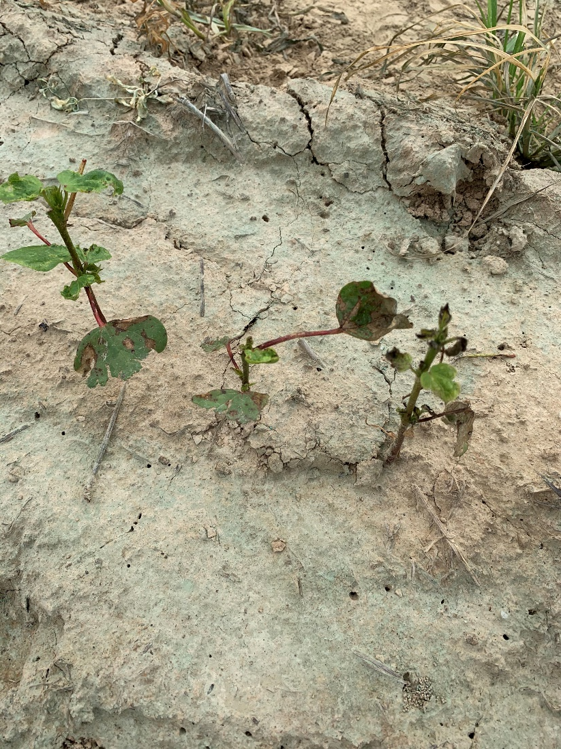
Trt 3: A22744 [E] 702 g a/ha + GRAMOXONE SL 3.0 562 g a/ha – 3 day after spray cotton close up

Slide 44
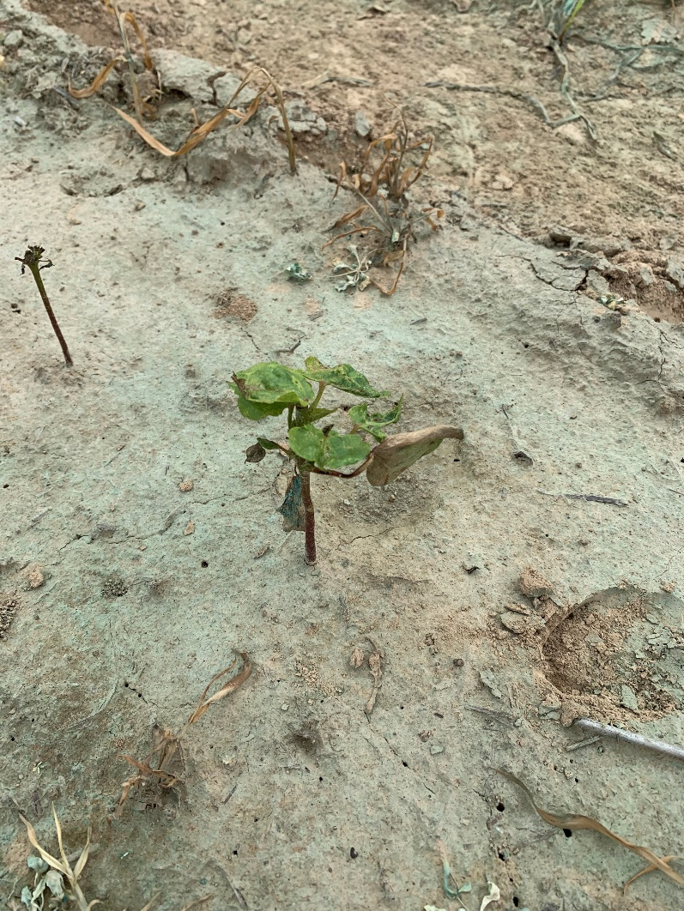
Trt 4: A22744 [C] 702 g a/ha + GRAMOXONE SL 3.0 562 g a/ha – 3 day after spray cotton close up

Slide 45
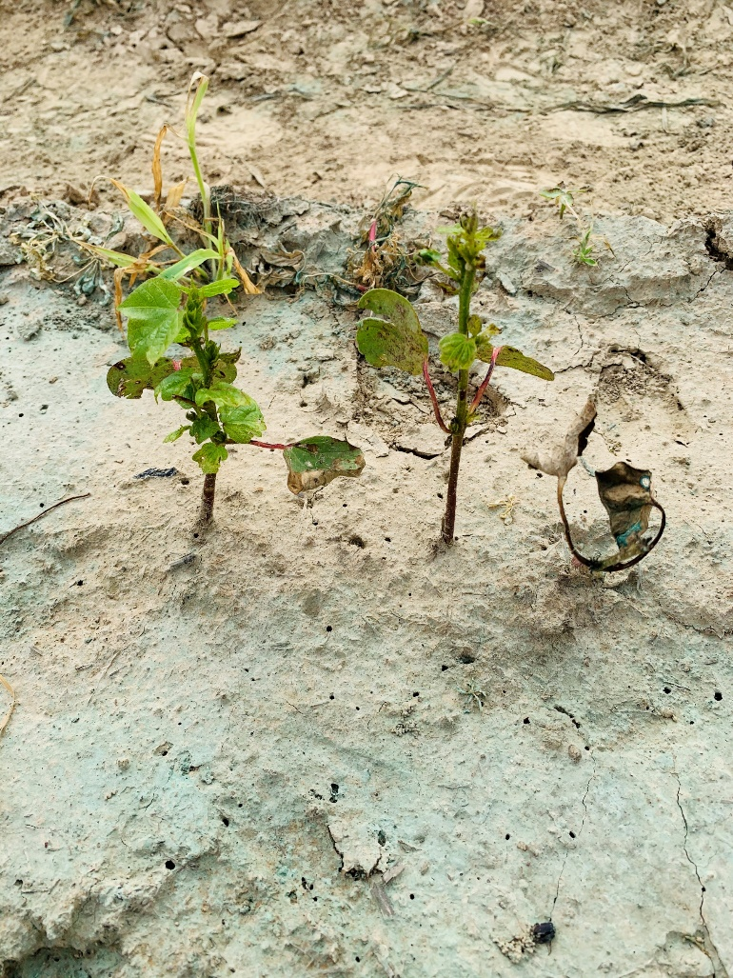
Trt 5: AMSOL 2.5 % v/v + SYN550593 (200) GA/L 1000 g a/ha – 3 day after spray cotton close up

Slide 46
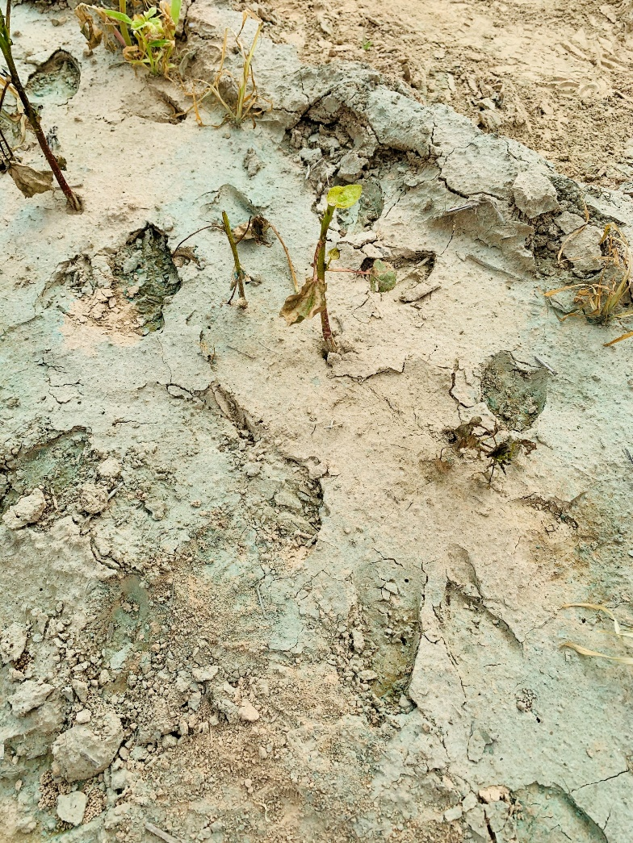
Trt 6: AMSOL 2.5 % v/v + SYN550593 (200) GA/L 1000 g a/ha + SLES (200) GA/L 1.25 % v/v – 3 day after spray cotton close up

Slide 47

Trt 7: AMSOL 2.5 % v/v + SYN550593 (200) GA/L 1000 g a/ha + SLES (200) GA/L 1.25 % v/v + ONTARGET 0.5 % v/v – 3 day after spray cotton close up

Slide 48
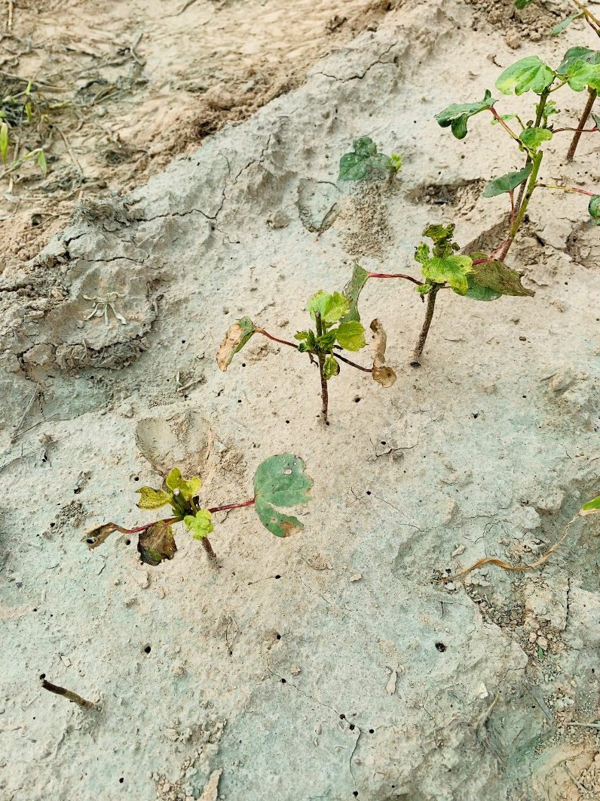
Trt 8: AMSOL 2.5 % v/v + SYN550593 (200) GA/L 1000 g a/ha + SLES (200) GA/L 1.25 % v/v + INTERLOCK 0.1 % v/v – 3 day after spray cotton close up

Slide 49
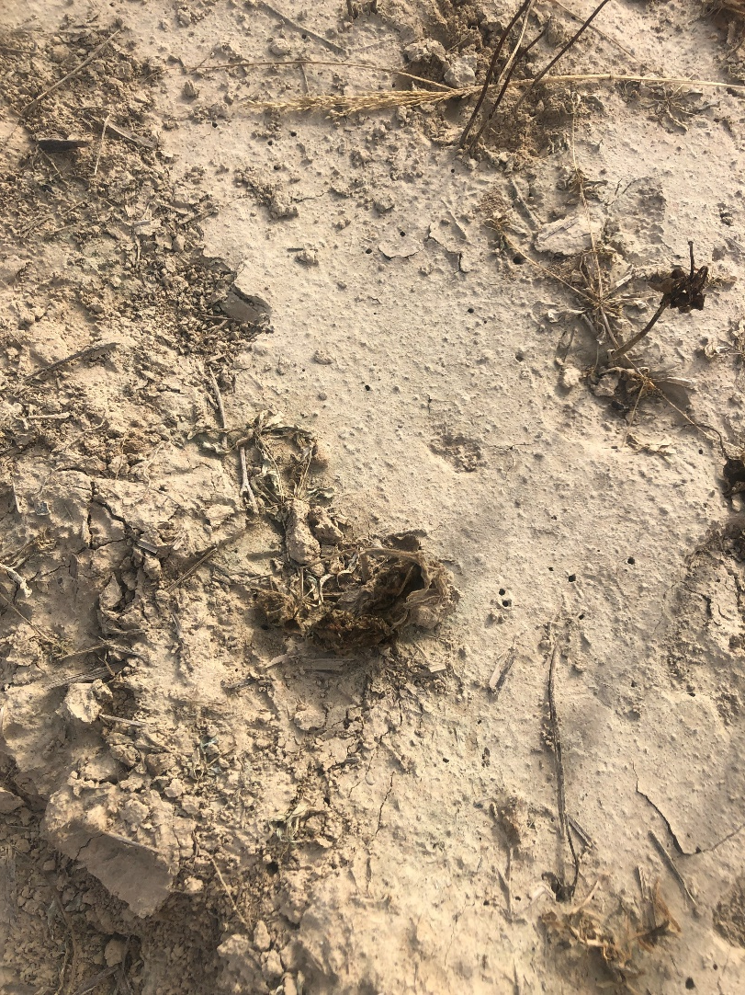
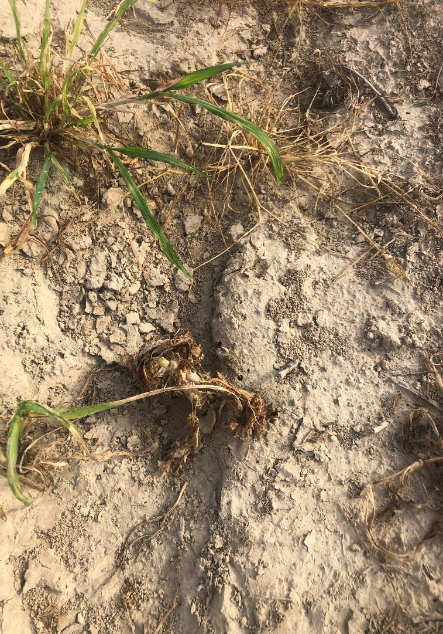
Trt 1: A22742 [A] 702 g a/ha + GRAMOXONE SL 3.0 562 g a/ha – Day 8 weed close ups

Slide 50
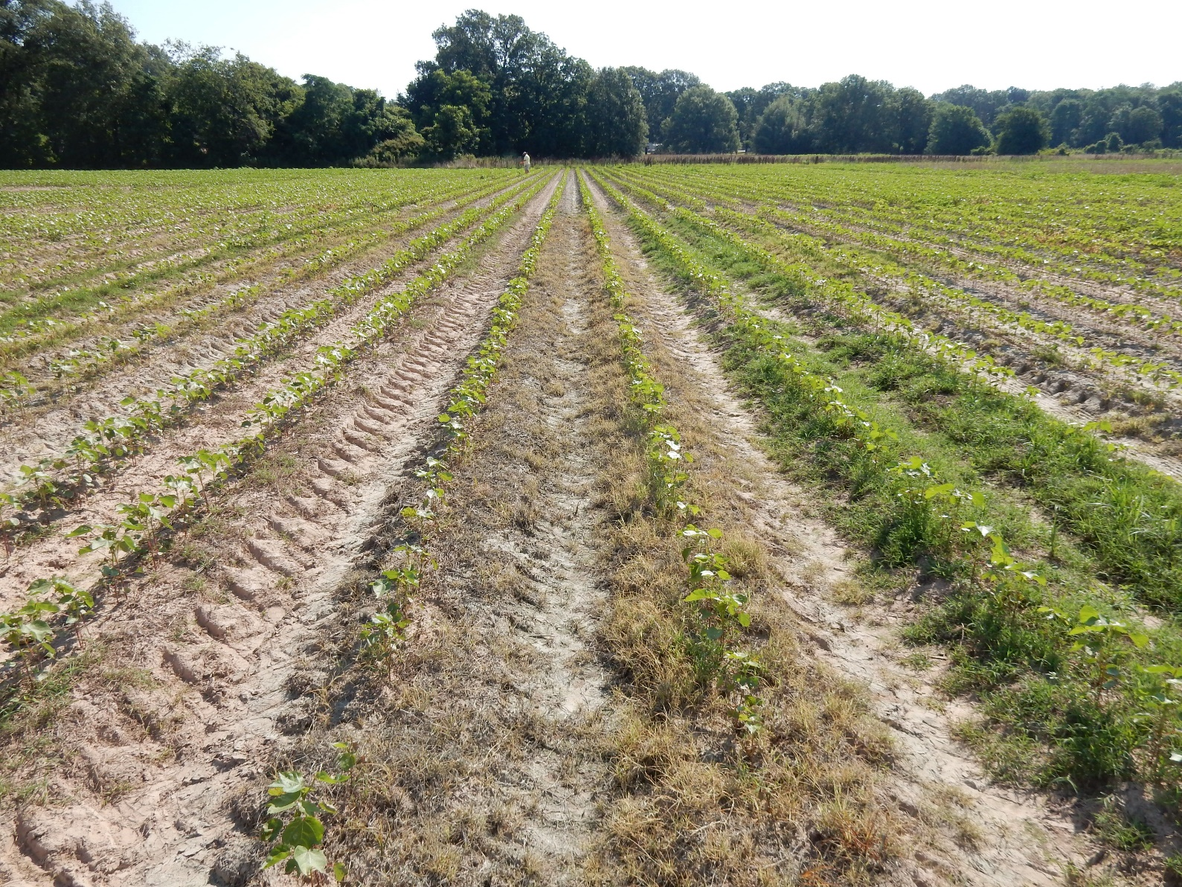
Trt 4: A22744 [C] 702 g a/ha + GRAMOXONE SL 3.0 562 g a/ha - AR

Slide 51
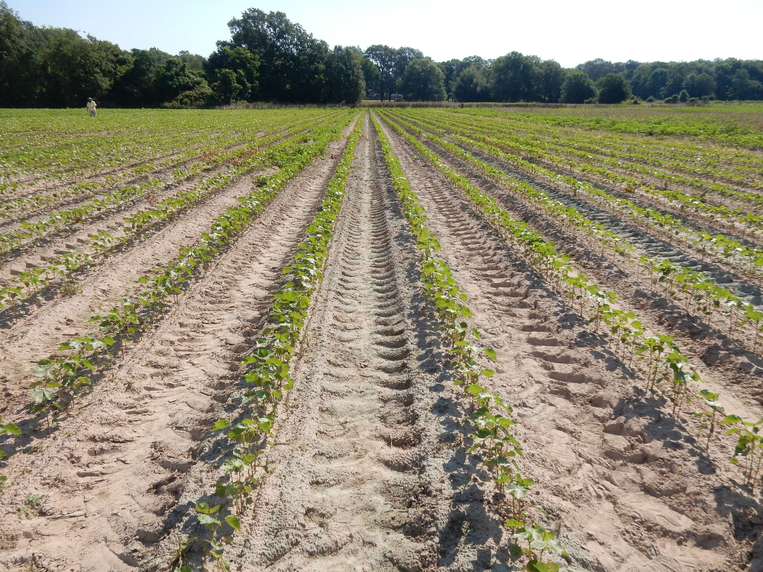
Trt 7: AMSOL 2.5 % v/v + SYN550593 (200) GA/L 1000 g a/ha + SLES (200) GA/L 1.25 % v/v + ONTARGET 0.5 % v/v - AR

Slide 52
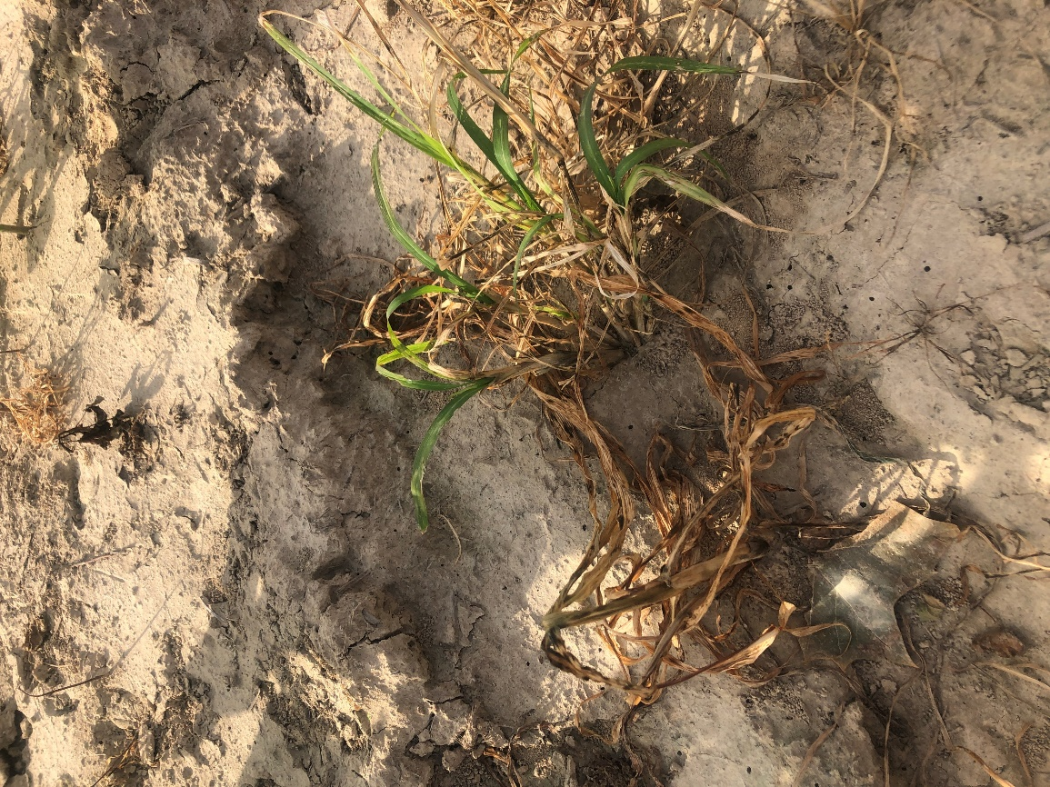
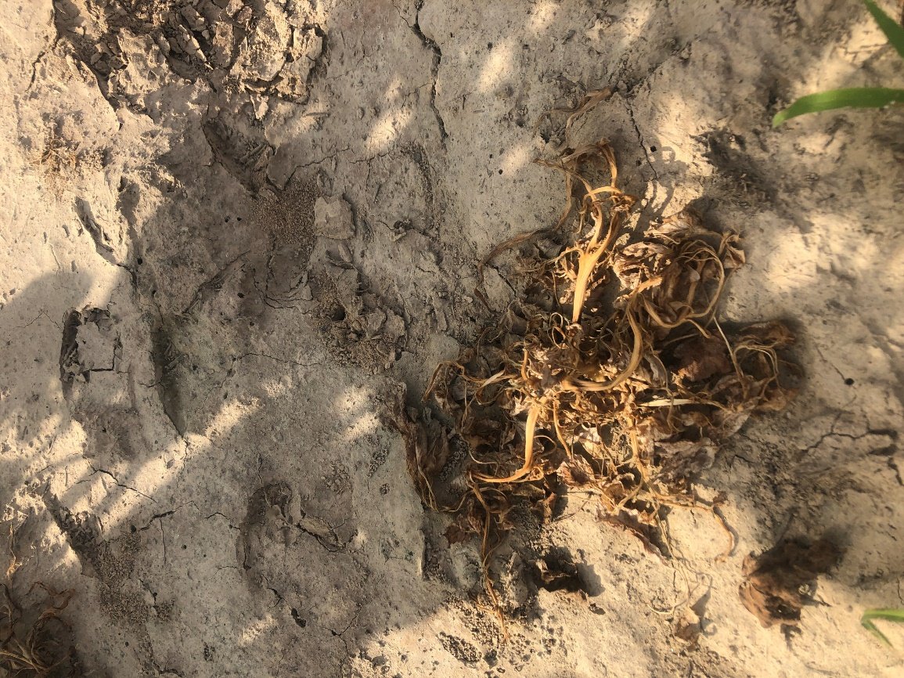
Trt 2: A22744 [D] 702 g a/ha + GRAMOXONE SL 3.0 562 g a/ha – Day 8 weed close ups - TN

Slide 53
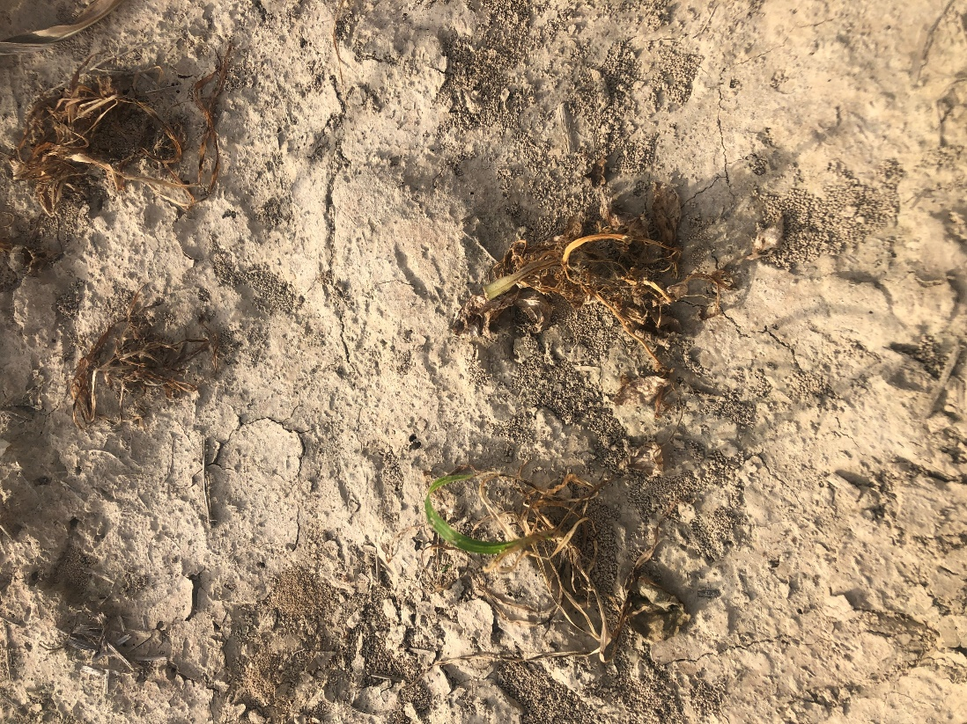
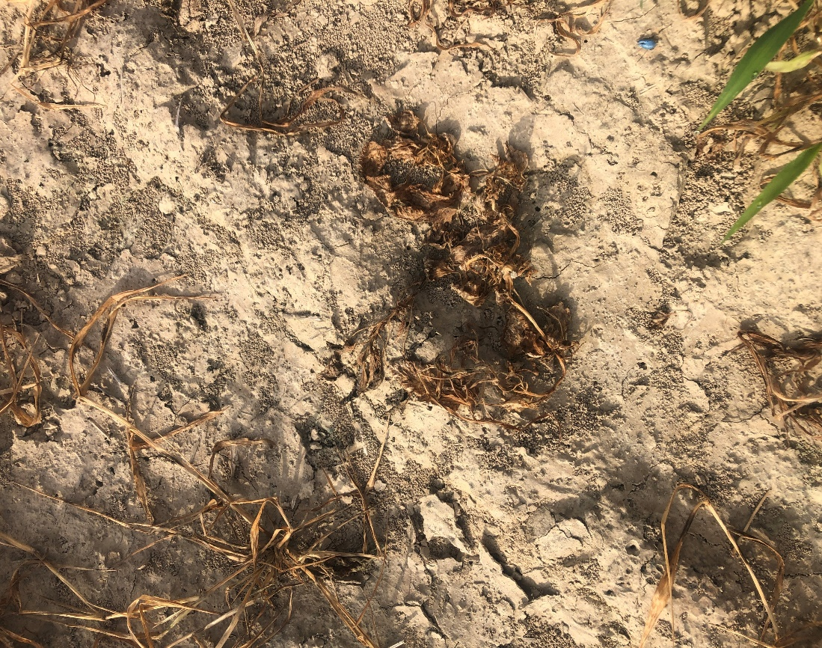
Trt 3: A22744 [E] 702 g a/ha + GRAMOXONE SL 3.0 562 g a/ha – Day 8 weed close ups

Slide 54
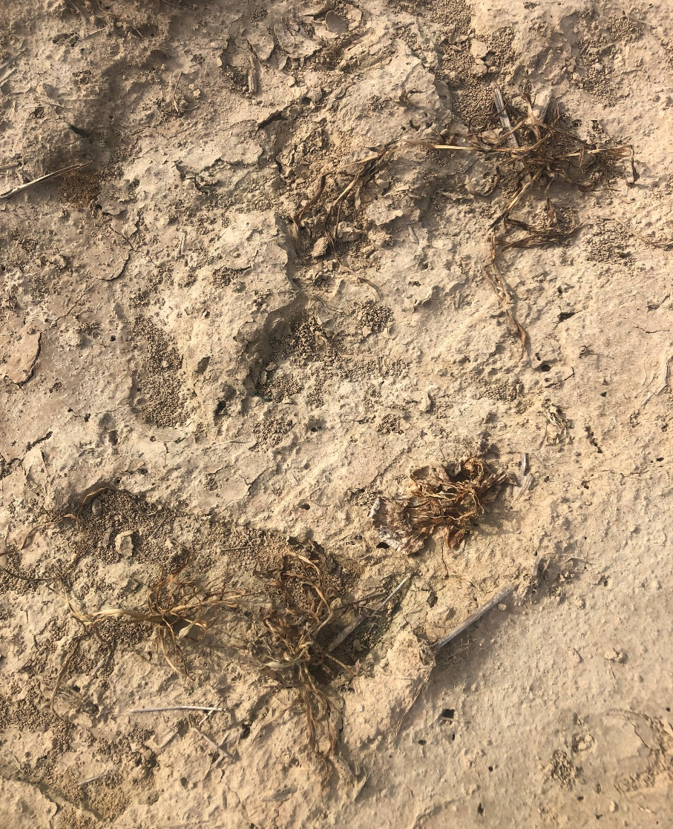
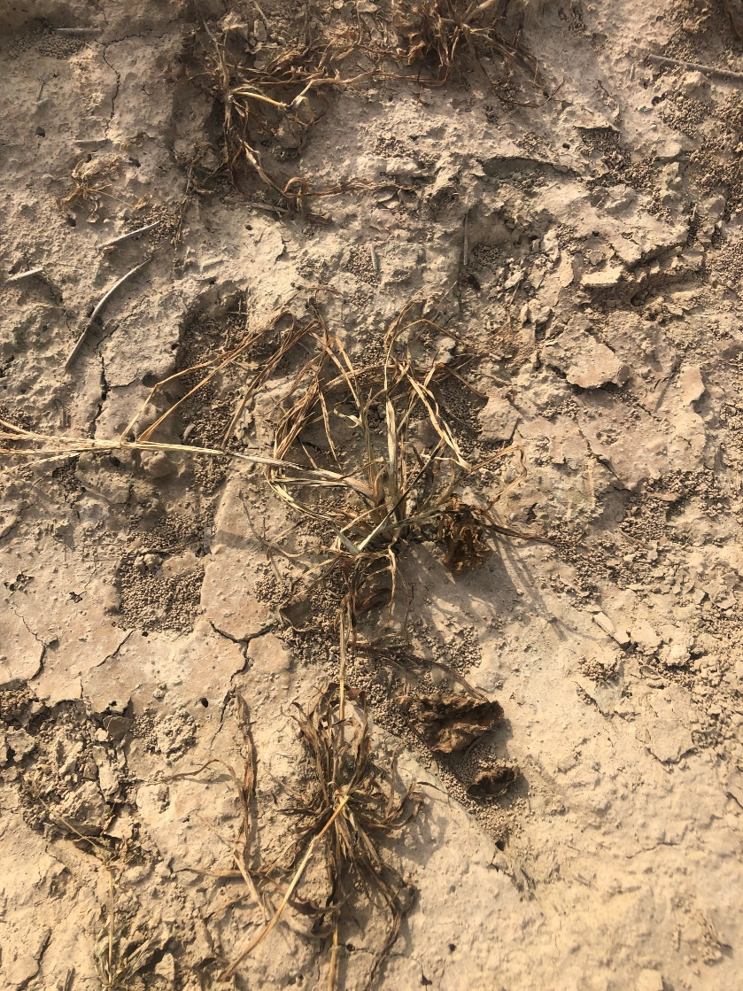
Trt 4: A22744 [C] 702 g a/ha + GRAMOXONE SL 3.0 562 g a/ha – Day 8 weed close ups

Slide 55
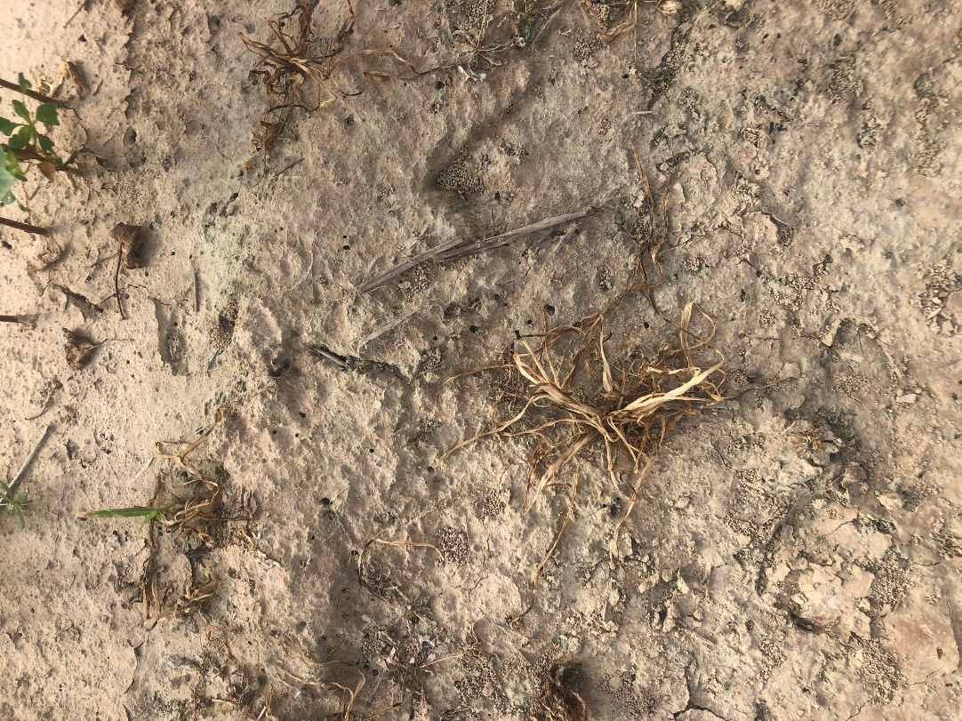
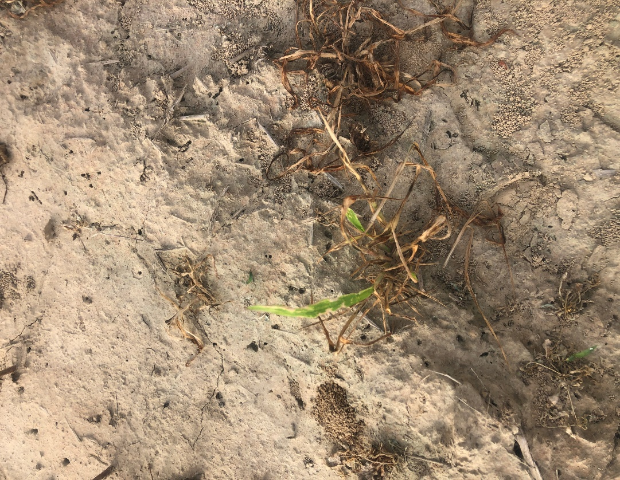
Trt 5: AMSOL 2.5 % v/v + SYN550593 (200) GA/L 1000 g a/ha – Day 8 weed close ups

Slide 56
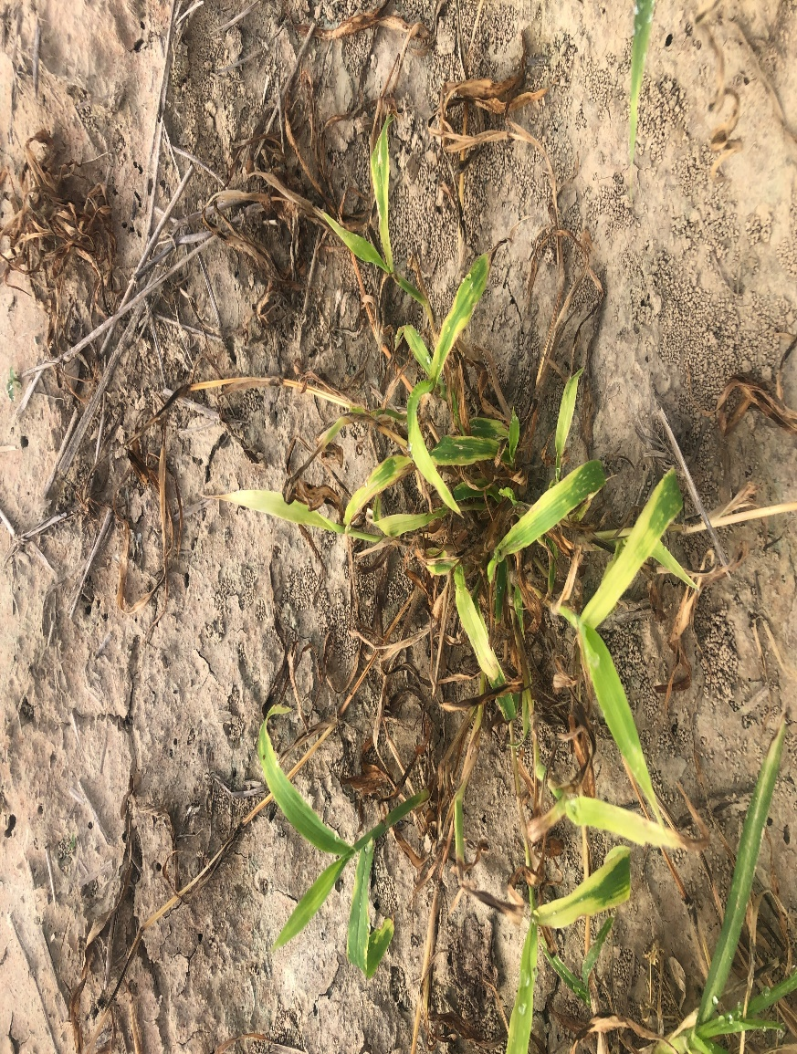
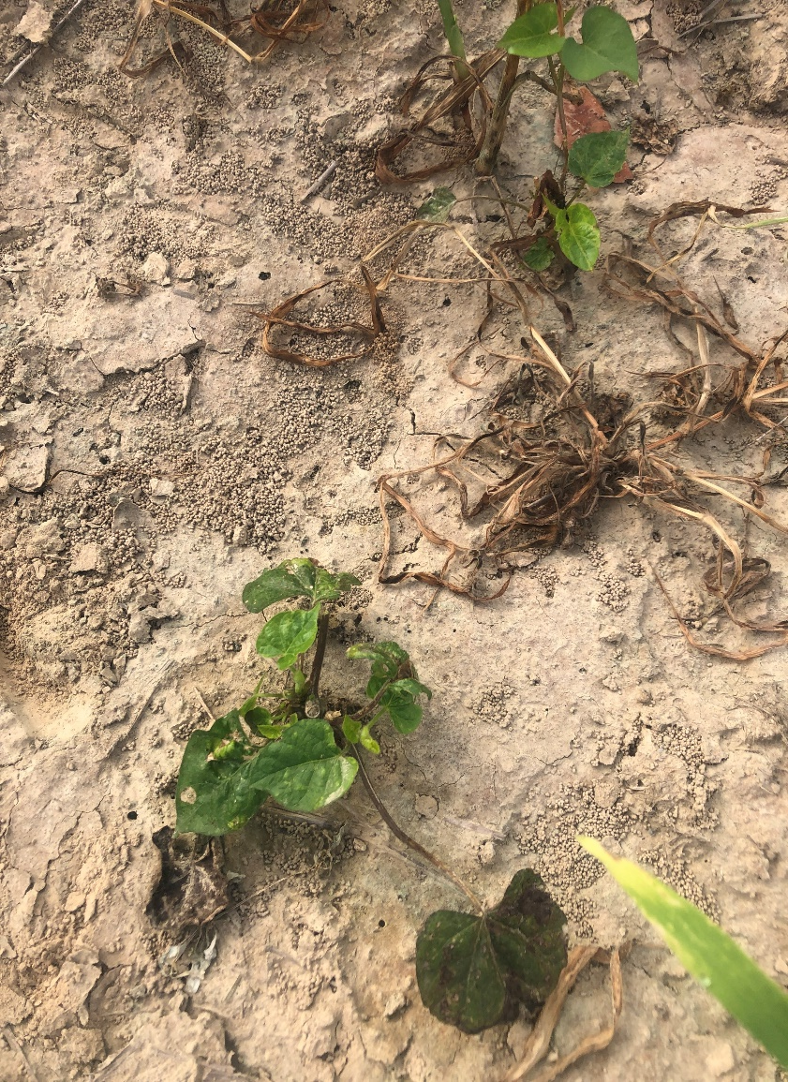
Trt 6: AMSOL 2.5 % v/v + SYN550593 (200) GA/L 1000 g a/ha + SLES (200) GA/L 1.25 % v/v – Day 8 weed close ups

Slide 57
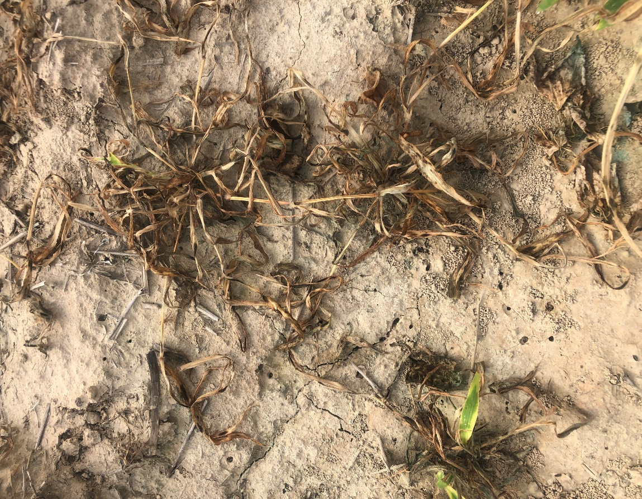
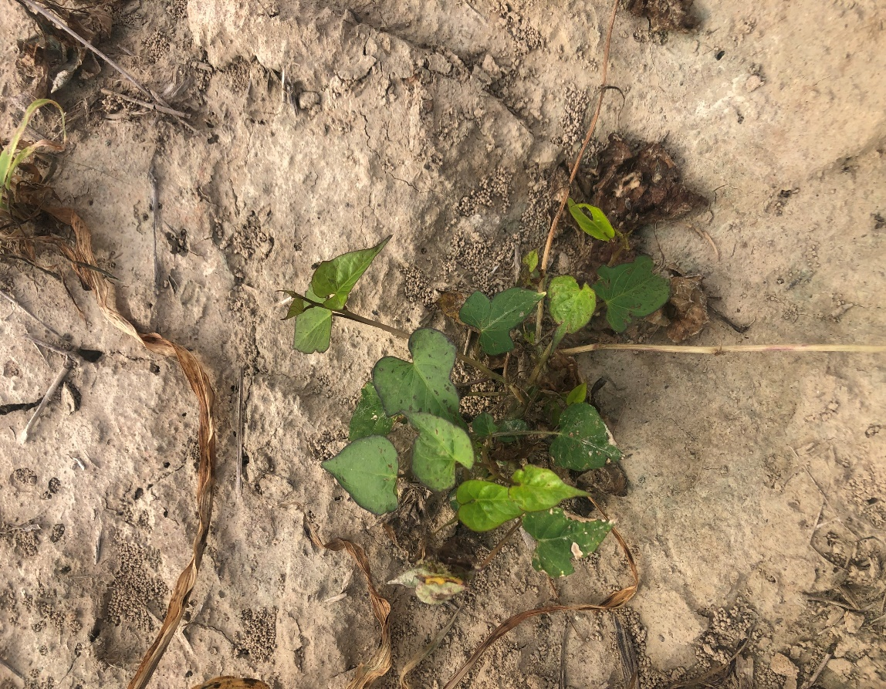
Trt 7: AMSOL 2.5 % v/v + SYN550593 (200) GA/L 1000 g a/ha + SLES (200) GA/L 1.25 % v/v + ONTARGET 0.5 % v/v – Day 8 weed close ups - TN

Slide 58
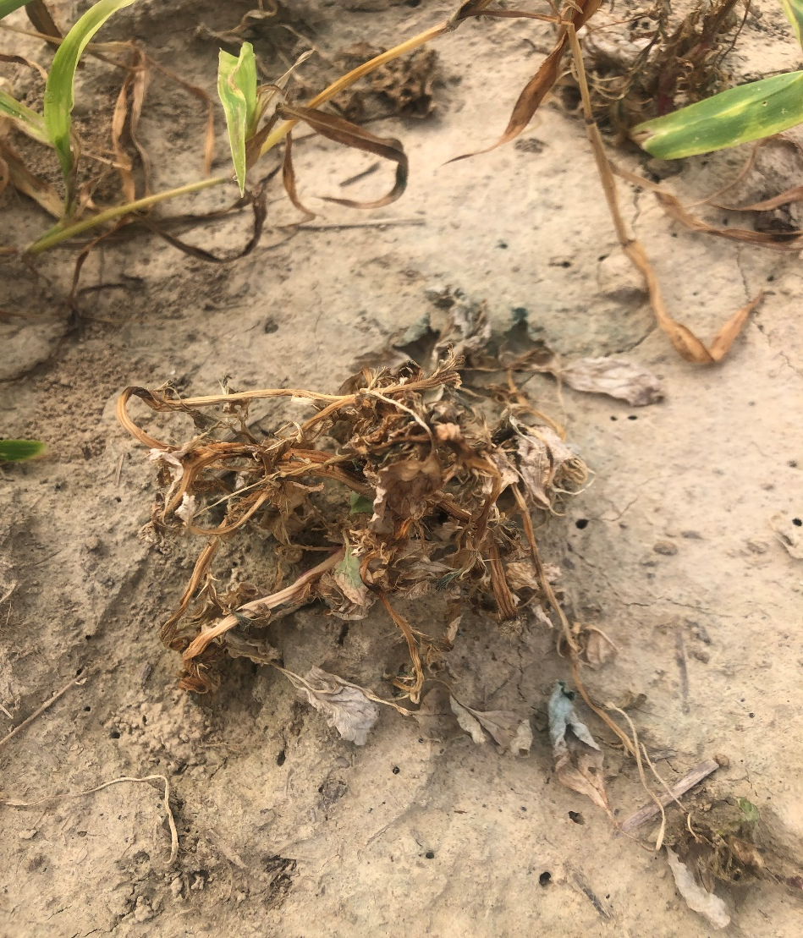
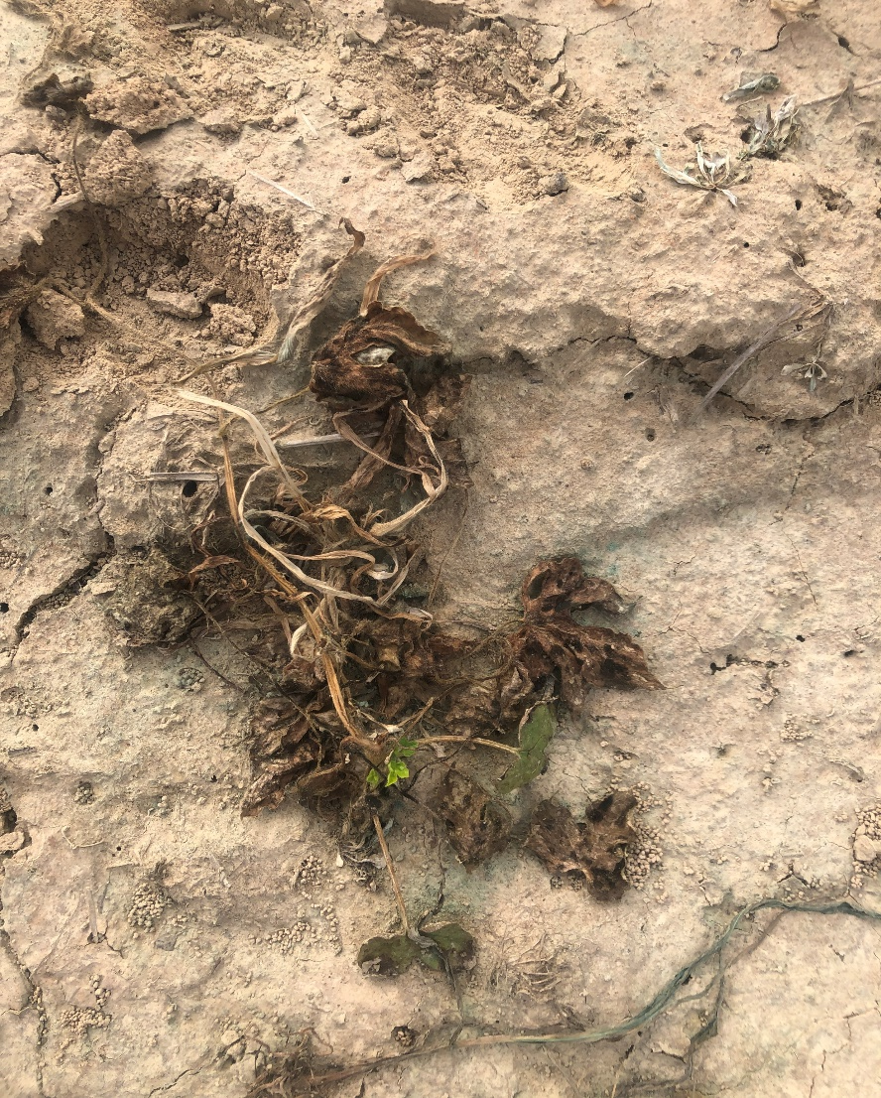
Trt 8: AMSOL 2.5 % v/v + SYN550593 (200) GA/L 1000 g a/ha + SLES (200) GA/L 1.25 % v/v + INTERLOCK 0.1 % v/v – Day 8 weed close ups

Slide 59
MS – IH Location
Ryan Jackson
Sprayed June 17th, 2020

Slide 60
Title: Evaluation of an experimental herbicide formulation alone, and Caparol in tank mix with Gramoxone 3.0 SL, for weed control and crop safety in cotton using See and Spray Technology
Trial: USSB0H0122020
SITE INFORMATION:
Location: Jackson Ryan FS
Address: 203 CR 186 Greenwood,MS
Soil Texture: silt loam Tillage Type: conventional-till
PLOT WIDTH: 6.33 ft REPS: 3
PLOT LENGTH: 50 ft TREATMENTS: 8
STUDY DESIGN: RACOBL
OVERALL MOISTURE CONDITION:
APPL Date Soil Temperature Moisture:
A Jun-17-2020
B Jun-17-2020
CROP INFORMATION:
CROP: GOSSS Variety: XtendFlex
PLANTING DATE: May-25-2020 PLANTING_METHOD: planted
PLANTING RATE: 45000 Depth: 0.75 in

Slide 61
Pest at Application
Pest Stage At APPLICATION:
A Jun-17-2020
Pest: ELEIN Eleusine indica Goosegrass
Pest Height: 0.25 in 2.5
Stage: 10 12
Density:
Pest: SIDSP Sida spinosa Prickly sida
Pest Height: 0.5 in 2
Stage: 11 13
Density:
B Jun-17-2020
Pest: ELEIN Eleusine indica Goosegrass
Pest Height: 0.25 in 2.5
Stage: 10 12
Density:
Pest: SIDSP Sida spinosa Prickly sida
Pest Height: 0.5 in 2
Stage: 11 13
Density:

Slide 62
Application Code: A
Date Time: Jun-17-2020:11:00
EQUIPMENT:
NOZZLE TYPE: FLAEVE
SPACING:
BOOM LENGTH:
BAND WIDTH:
GROUND SPEED: 4 mph
PRESSURE: 55 psi
SPRAY VOLUME: 55 gal/ac
SPRAY Ph:
WEATHER AT APPLICATION:
Timing: POSPOS
AIR TEMP:

Slide 63
Application Code: B
Date Time: Jun-17-2020:12:01
EQUIPMENT:
NOZZLE TYPE: FLAEVE
SPACING:
BOOM LENGTH:
BAND WIDTH:
GROUND SPEED: 4 mph
PRESSURE: 55 psi
SPRAY VOLUME: 55 gal/ac
SPRAY Ph:
WEATHER AT APPLICATION:
Timing: POSPOS
AIR TEMP:

Slide 64
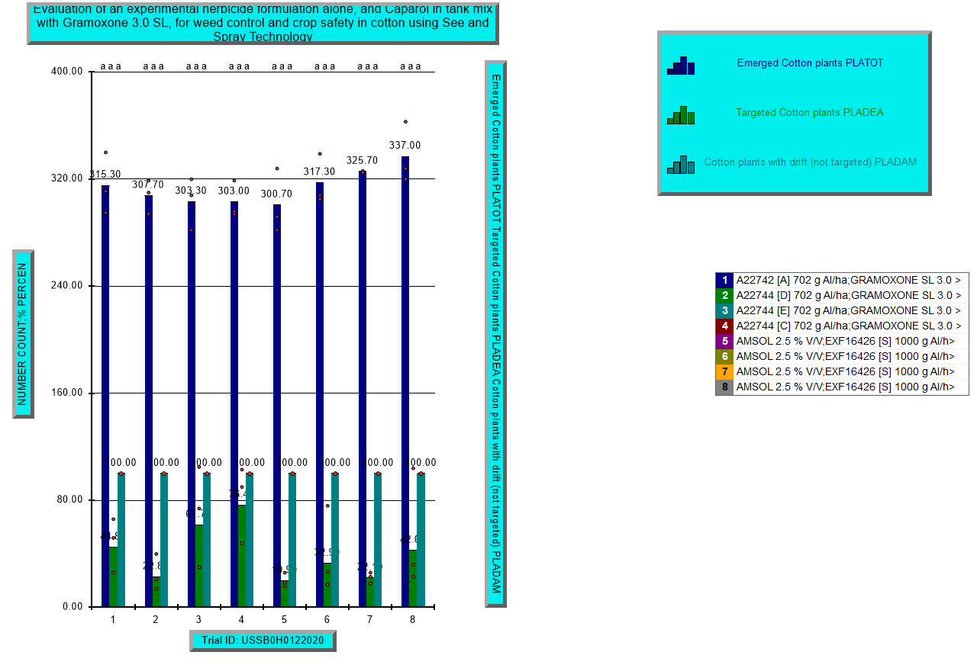
Cotton Plants: Total emerged, targeted at application and damaged 3 days after application – MS

Slide 65
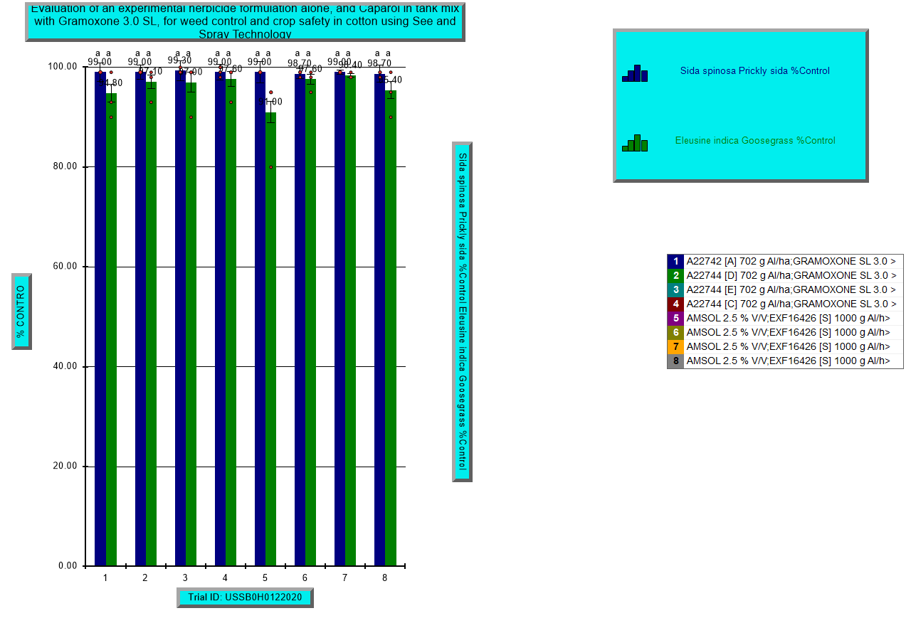
Weed Control - 4 days after application – MS

Slide 66
MS – CRO Location
Ryan Jackson – Tyler Horn
Sprayed June 12th, 2020
Initial cotton stand before application was not taken

Slide 67
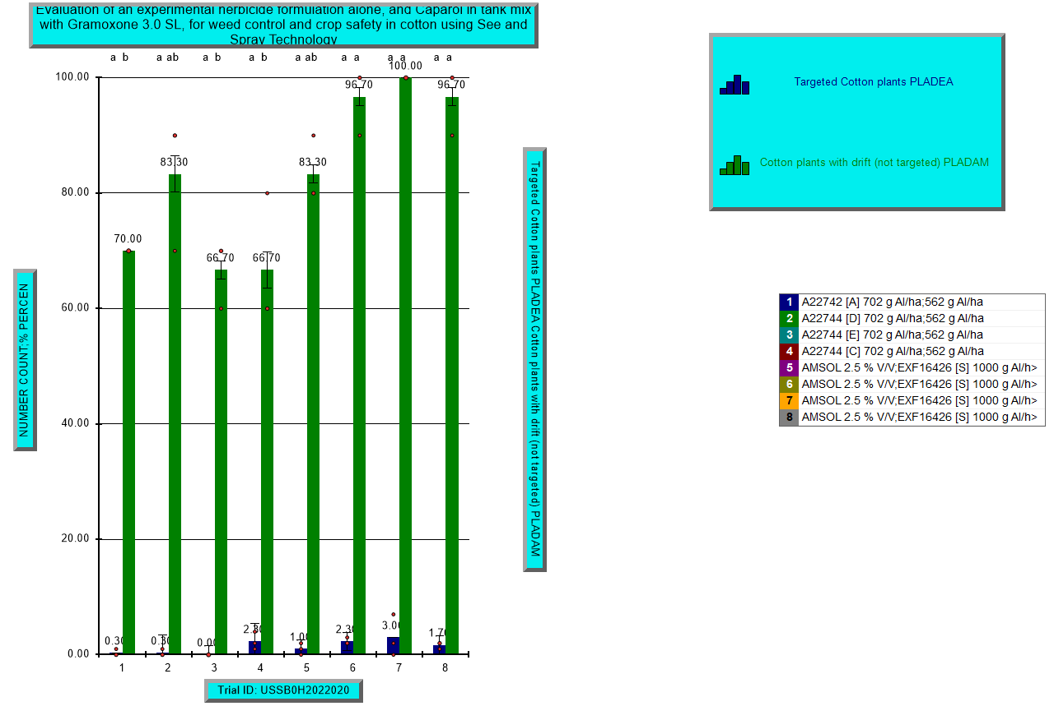
Cotton Plants: Total emerged, targeted at application and damaged 4 days after application – MS - CRO

Slide 68
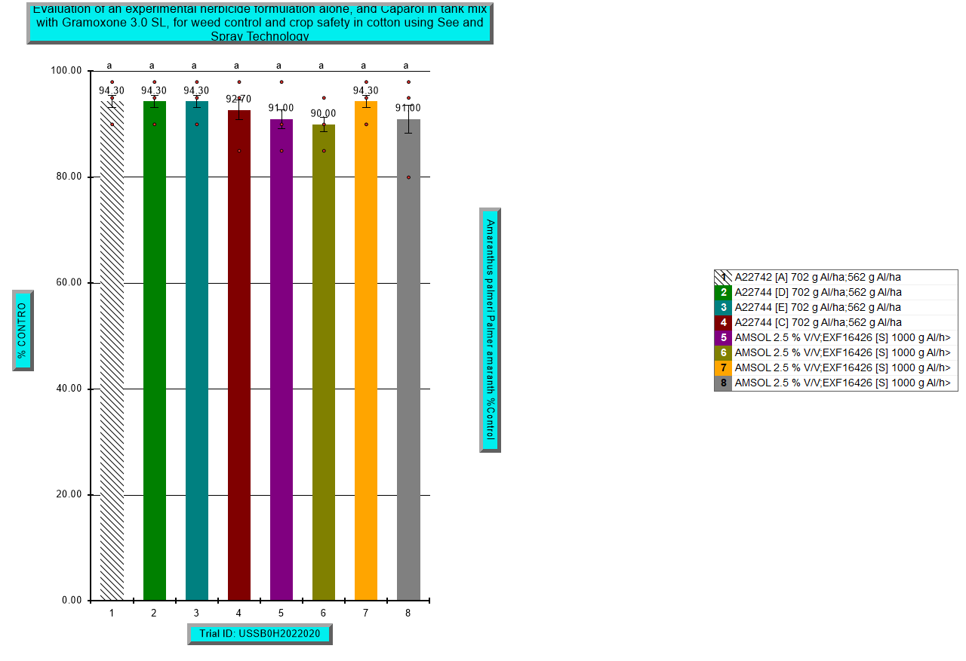
Weed Control - 5 days after application – MS - CRO

Slide 69
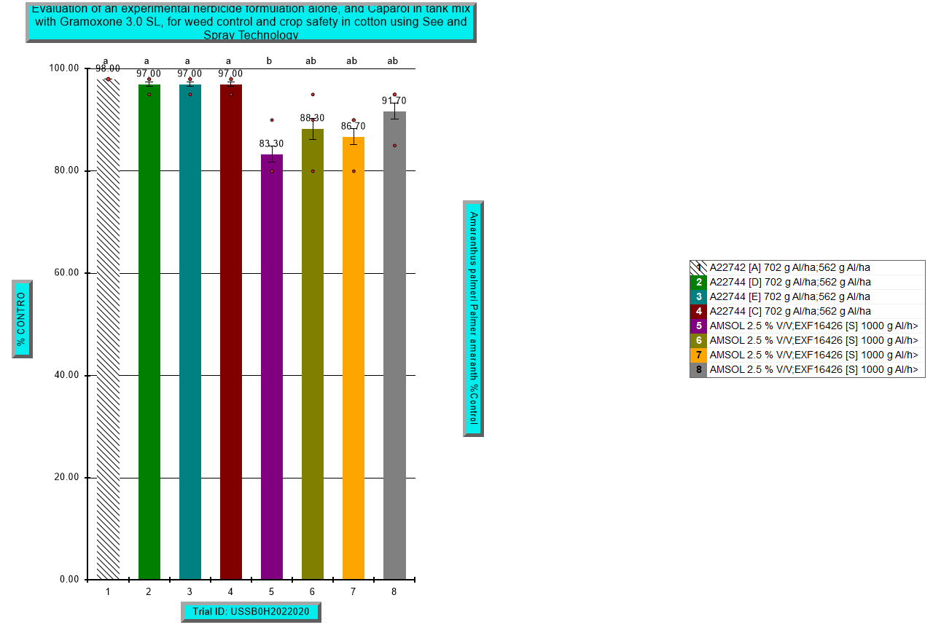
Weed Control - 8 days after application – MS - CRO

Slide 70
AR – COI Location
Dave Black – Tom Barber
7 DAT pictures

Slide 71

Trt 1: A22742 [A] 702 g a/ha + GRAMOXONE SL 3.0 562 g a/ha

Slide 72

Trt 2: A22744 [D] 702 g a/ha + GRAMOXONE SL 3.0 562 g a/ha

Slide 73

Trt 3: A22744 [E] 702 g a/ha + GRAMOXONE SL 3.0 562 g a/ha

Slide 74

Trt 5: AMSOL 2.5 % v/v + SYN550593 (200) GA/L 1000 g a/ha

Slide 75

Trt 6: AMSOL 2.5 % v/v + SYN550593 (200) GA/L 1000 g a/ha + SLES (200) GA/L 1.25 % v/v

Slide 76

Trt 8: AMSOL 2.5 % v/v + SYN550593 (200) GA/L 1000 g a/ha + SLES (200) GA/L 1.25 % v/v + INTERLOCK 0.1 % v/v

